Slide 1


Slide 2
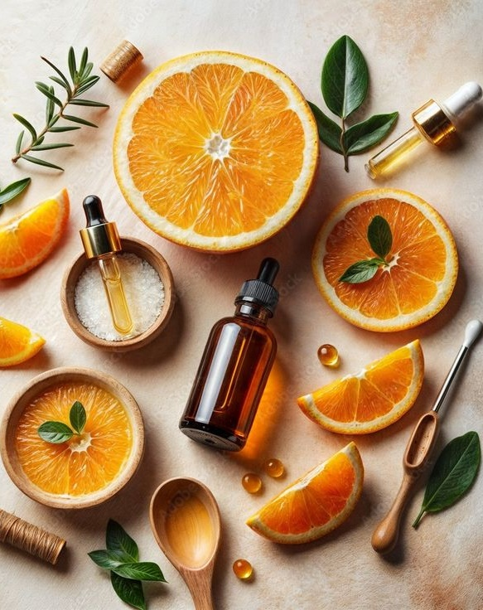

Agenda
01
The Vitamins Journey
02
Vitamin C – Antioxidant Superhero
03
Vitamin B3 – Multi Benefits Wonder
04
Vitamin B12 – Sensitive Skin Specialist
05
Vitamin B5 – Moisturizer & Healer
06
Vitamin A – The Golden Age Defyer
07
Vitamin E – The Defender
08
Beauplex VH – All in one Vitamin Blend

Slide 3

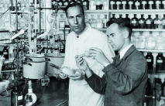
The Vitamins Journey
From discovery to industrialization
1911
Kazimierz Funk called ‘Vitamin’ (Vital Amine) this nutritional factor (Thiamin), creating the revolutionary concept of nutritional factor essential for Life, and that Humans (and Animals) need to find in daily food.
1936
Vitamin C.
It was at today’s DSM’s site in Grenzach, Germany, that vitamin C has been first industrially produced. The revolutionary process proposed by the biochemist Tadeusz Reichstein to Roche is the base of the production technique still in use today.
1944
Panthenol.
The Swiss scientist Dr. Gustav Erlemann discovers that panthenol works wonders on the hair – helping to repair damaged hair. Inspired by panthenol properties, Pantene® Hair tonic, created by Hoffman-LaRoche, makes its debut as a premium hair care line across Europe.
1930
Vitamin A
The discovery of Retinol.
1938
Vitamin E is produced industrially. Otto Isler, who joins Roche in 1936, succeeds in 1938, together with P. Karrer and A.R Todd in the industrial production of Vitamin E.
1945
Vitamin E
The first antioxidant theory of vitamin E activity is proposed by Danish biochemist Henrik Dam and his coworkers.
1947
DSM pioneered the large-scale industrial synthesis and production of vitamins.
1990s
Vitamin B12 is produced for pharmaceutical application.
1994
Panthenol and Ascorbic acid production started at todays DSM’s site in Dalry, Scotland.
2022
DSM launches a naturally derived grade of vitamin B12 in PC portfolio (INCI: Cyanocobalamin) produced via non-GMO bacterial fermentation, with natural origin index of 68.7%, and both Halal-approved and vegan-compliant.
1911
1938
1945
1990
Today
3

Slide 4
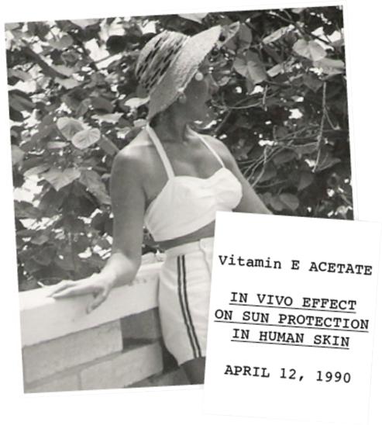






dsm-firmenich Pioneer & Leader
Leading the way in understanding the role of vitamins in cosmetics: First efficacy studies initiated on Panthenol, Vitamin A and Vitamin E have been highly recognized in the cosmetic industry
dsm-firmenich – A leader in the vitamin journey since 1936
The longest-standing producer of vitamins in the world
First to explore the beauty of potential of vitamins in beauty and personal care
The 1st to bring vitamins production
on the industrial level
Today, dsm-firmenich remains fully committed to explore the beauty potential of our vitamins further.
Comprehensive portfolio: Full range of 13 vitamins, including the most demanded forms for cosmetics
Leading production capabilities: DSM high commitment to keep technology leadership at best value for money
Vitamin C industrial production, Grenzach, 1936
4

Slide 5
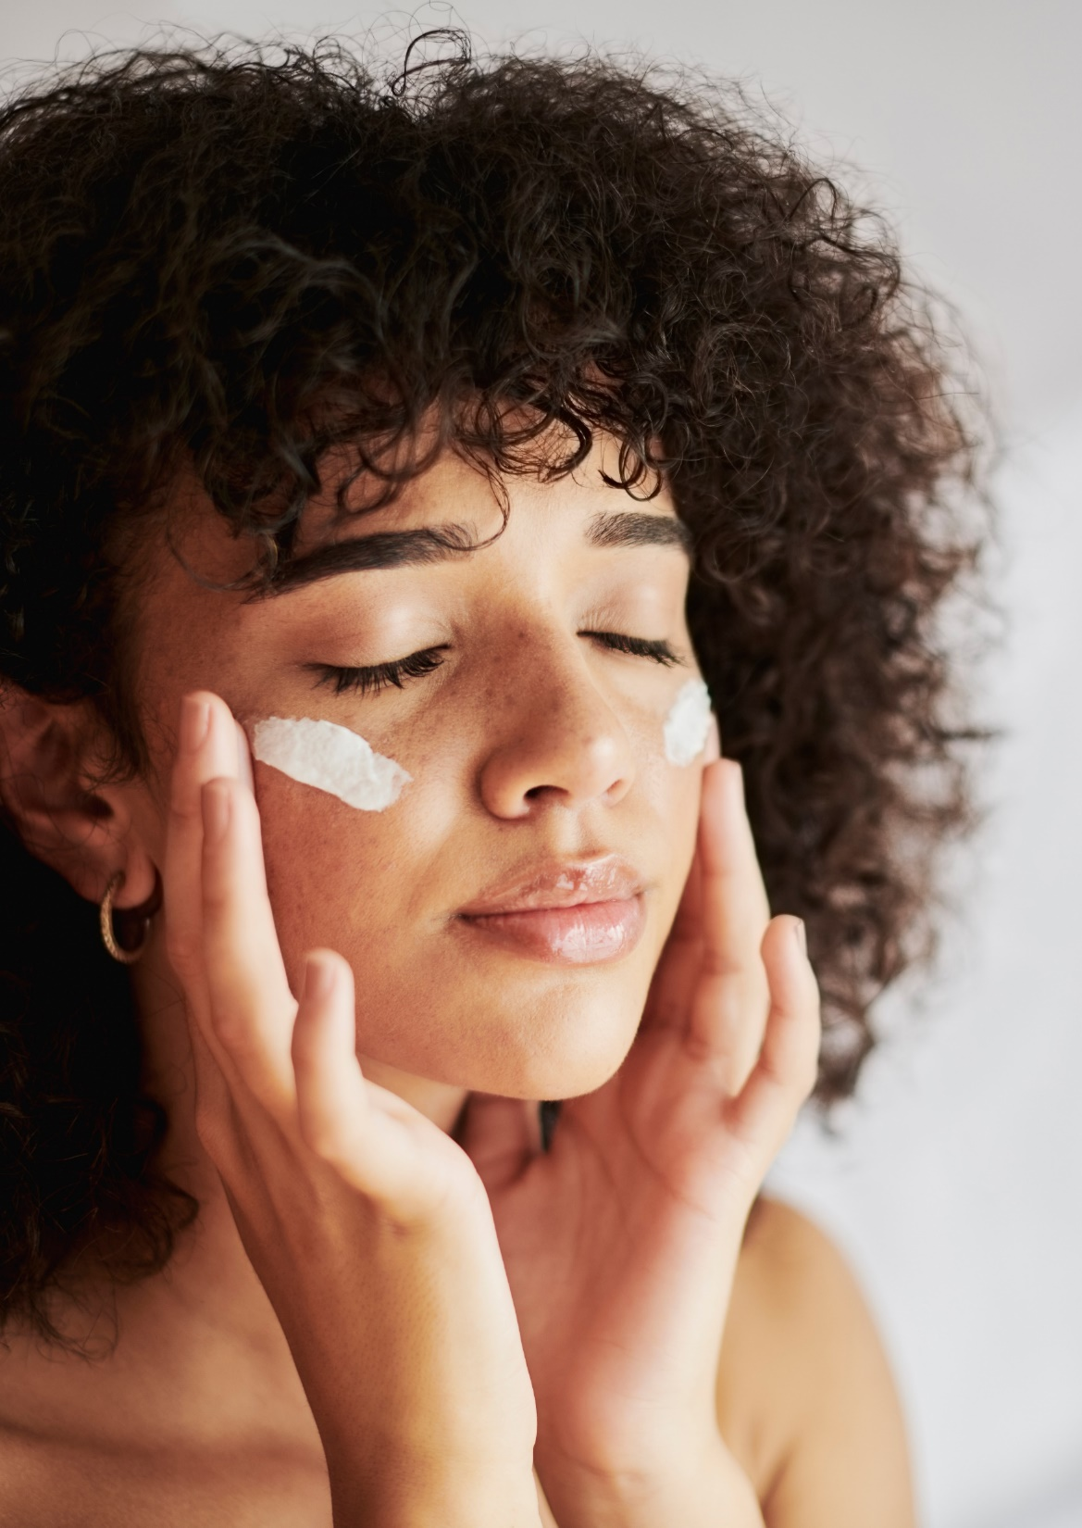
The importance of Vitamins-rich skincare routine
Humans are unable to synthesize Vitamin and therefore rely entirely on external supplementation such as topical application.
Epidermis doesn’t contain blood vessels that supply the cells with nutrients, therefore topical application of vitamins can effectively complement dietary consumption, leading to a stronger and healthier protective barrier.
Skin is the primary defense organ, constantly exposed to external aggressors: a solid, properly nourished skin immune system can help protect from invading pathogens, cause of dermatologic problems.
Zussman J, et al. Vitamins and photoaging: do scientific data support their use? 2010, J Am Acad Dermatol
Matejuk, A. Skin Immunity. Arch. Immunol. Ther. Exp. (2018)
Notes:
1. The Role of Vitamins in the Body
Vitamins are essential organic compounds that the body requires for various physiological functions. Since humans cannot synthesize most vitamins (except for vitamin D and small amounts of vitamin K and B3), we rely on external sources such as diet and supplements.
2. Why Topical Vitamins Matter for Skin
Since the epidermis lacks blood vessels, nutrients from food or oral supplements may not reach it efficiently. This is why topical application of vitamins can be an effective way to deliver key nutrients directly to the skin.
3. Key Vitamins for Skin Health
Here are some essential vitamins that play a major role in maintaining skin function and appearance:
Vitamin A (Retinoids & Carotenoids)
Essential for cell turnover, collagen production, and skin renewal.
Helps reduce wrinkles, acne, and hyperpigmentation.
Sources: Retinol creams, serums, and beta-carotene from vegetables.
Vitamin B Complex (B3, B5, B6, B12, etc.)
Vitamin B3 (Niacinamide): Improves skin elasticity, barrier function, and reduces inflammation.
Vitamin B5 (Panthenol): Hydrating, soothing, and helps with wound healing.
Sources: Found in serums, moisturizers, and toners.
Vitamin C (Ascorbic Acid)
A potent antioxidant that protects against oxidative stress (UV damage, pollution).
Boosts collagen synthesis and brightens the skin.
Sources: Citrus fruits, serums, creams.
Vitamin D
Important for skin immune function and inflammatory responses.
Synthesized in the skin through sunlight exposure.
Sources: Sun exposure, fortified foods, and vitamin D creams.
Vitamin E (Tocopherol)
A strong antioxidant that helps repair damaged skin.
Works synergistically with vitamin C for enhanced skin protection.
Sources: Plant-based oils, serums, and creams.
Vitamin K
Helps with wound healing, dark circles, and bruising.
Sources: Leafy greens, topical creams.
4. The Skin as a Protective Barrier
Since the skin is the first line of defense against environmental aggressors (pollution, UV radiation, bacteria), maintaining a strong skin barrier with proper vitamins can help:
Reduce oxidative stress.
Strengthen the immune response.
Prevent dermatological issues like eczema, acne, and premature aging.
5. How to Choose the Right Topical Vitamins
Stability: Vitamin C, for instance, can degrade easily, so formulations like ascorbyl palmitate or magnesium ascorbyl phosphate are more stable.
Penetration: Ingredients need to be formulated in a way that allows them to pass through the skin’s barrier.
Combination: Some vitamins work better together, like Vitamin C + Vitamin E (for enhanced antioxidant protection).

Slide 6
The 13 vitamins essential to life
Liposoluble
Vitamins
Vitamin A
Retinol
Beta carotene
Vitamin D3
Cholecalciferol
Vitamin E
Tocopherols
Vitamin K
Phylloquinone
Watersoluble
Vitamins
Vitamin B1
Thiamine
Vitamin B2
Riboflavin
Vitamin B3 / PP
Nicotinic acid
Nicotinamide
Vitamin B5
Pantothenic acid
Vitamin B6
Pyridoxine HCl
Vitamin B7
Biotin
Vitamin B9
Folic Acid
Vitamin B12
Cobalamin
Vitamin C
Ascorbic acid

Slide 7
B&C Vitamins portfolio at dsm-firmenich
Liposoluble
Vitamins
Retinol CB 50
The golden standard in anti-aging
Vitamin A palmitate
Vitamin E acetate & tocopherols
Antioxidant to protect alluring skin
Watersoluble
Vitamins
Vitamin B3
Niacinamide PC for flawless, resilient skin and a radiant complexion
Vitamin B5
Panthenol: the gold standard moisturizer for skin & hair
Vitamin B6
Pyridoxine Hydrochloride helps to reduce dandruff and sebum levels
Vitamin B7
Biotin improves the quality of keratin (hair & nails) and helps reduce age spots
Vitamin B9
Folic Acid: Powers cell renewal and prevention of
DNA damage
Vitamin B12
Cyanocobalamin sooth sensitive & stressed skin
Stay-C® 50
Vit. C derivative, The all-round beauty solution for skin so beautiful it glows
Vitamin C
Ascorbic acid
fine & ultra fine powder
BeauPlex® VH
5 Vitamins blend
B3, B5, B6, C & E

Slide 8





dsm-firmenich vitamins promise
Today we are adding value to our trusted heritage in Vitamins
With our Quality for Life™ seal we’re putting our customers and consumers
in the driving seat, with access to:
Quality
Quality is the cornerstone of our delivering. You can trust DSM to bring you products that are consistent in quality and high in purity.
Reliability
Our vitamins are reliable, meaning they will consistently deliver on their intended use — whether it is your skin cream, the milk you pack in your child’s lunch or the daily supplement you take to help ensure optimal nutrition.
Traceability
Our ability to track and verify the quality of our products throughout their life cycle is what makes traceability essential to answer the clean beauty.
Sustainability
Quality extends beyond products and services and includes our commitment to the environment, which we show by reducing the environmental impact of our activities while simultaneously optimizing land and resource use.
Our Vitamins that are not only of the highest quality, totally reliable and fully traceable, but have minimum impact on the planet
8

Slide 9





Made with care
Best in class for Vitamins
Based on life cycle analysis, our Quali® vitamins have the lowest carbon footprint across their respective industries.
Vitamins A & E
Lowest carbon and environmental footprints.
Vitamin E: up to 89% less from raw materials vs. conventional building blocks and 74% less from energy generation compared to coal-based production.
Vitamin B3
Niacinamide PC is crafted with natural-origin ingredients and powered primarily by Renewable Energy (by 2025).
It is readily biodegradable, and it has only 7.4 kg CO2 eq. / kg in carbon footprint.
Vitamin B6
Lowest Carbon Footprint by at least 10% compared to alternative production driven by the avoidance of coal-based steam, the use of renewable electricity and waste reduction.
Vitamin C
51% lower greenhouse gas emissions compared to average competitors. Production with 100% purchased renewable electricity (completing self-generated electricity and steam from burning natural gas).
Vitamin B5
Lowest Carbon and Environmental
Footprint driven by the avoidance of coal-based steam. Repurpose of waste generated into fertilizer and for land restoration.

Slide 10

Reliable Supply Chain Worldwide
Made with care
Vitamins B5 - C
STAY C 50
Vitamins B12 – B7
Vitamin B9
Vitamin D3
Vitamins B3 – B6 – B12
Vitamins A – E

Slide 11


Elevating sustainability at Dalry, Scotland, the United Kingdom
CO₂ emission reduction
of -22% since 2016
(while increasing production volumes)
Most recent reductions achieved with use of
high-tech digital solutions
(Digital Twins, Advanced Analytics,
Online Monitoring)
Energy transition program in planning stage to move to wind-energy as per 2026
(and options for heat being studied)
Diverse workforce across all age – groups and well recognized apprenticeship program
>99% of process waste is valorised in 2023
(as fertilizer / for land restoration)
Dalry Site selected for the first large scale production plant for Bovaer®
(>30% methane-emission reduction for cattle)
Key employer (direct and indirect) in North Ayrshire, on of the most deprived area in Scotland
Launch of the
DSM Chemical Engineering scholarship (4250£ and mentoring) in 2021

Slide 12
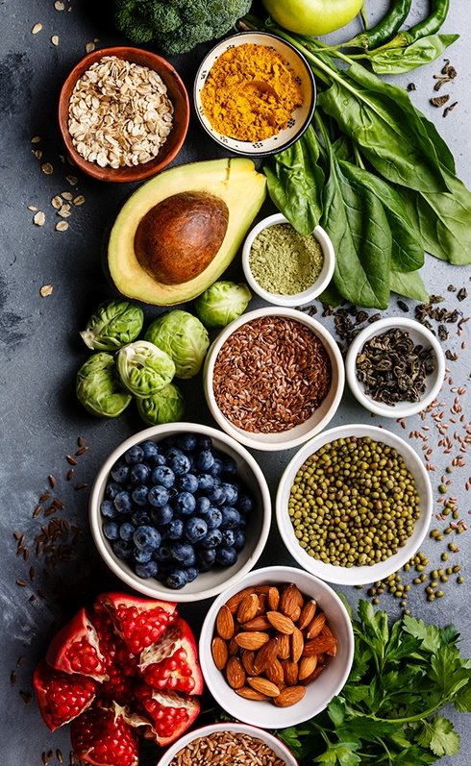
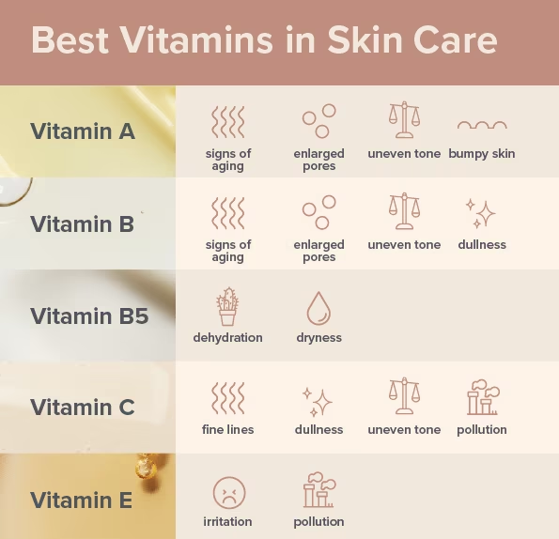
Hero Vitamins to nourish skin beauty
and keep skin defenses robust!
Golden Anti-Aging
Resilient & Radiant
Reduces skin photo-damage and discoloration
Improves the appearance of fine lines, wrinkles, firmness, and elasticity
Enhances skin smoothness and decreases roughness
Rebalances uneven skin tone and reduces mottled pigmentation
Vit. A
Vit. B3
Protects from external stressors (UV, blue light & pollution)
Rebalances even skin tone
Moisturizes and improves skin elasticity
Boosts skin immunity
Moisture & Restore
Sensitive & Stress
Strong skin moisturizer
Soothes irritated skin
Helps protect and regenerate compromised skin
Rejuvenates the skin
Tightens the skin barrier against external insults
Relieves sensitive and stressed skin, enhancing vibrancy
Speeds up cell recovery and regeneration, supporting the treatment of different skin conditions
Prevents photo-damage and protects against inflammation
Maintains healthy skin microbiome
Vit. B5
Vit. B12
Energize & Glow
Anti-oxidant & Protect
Vit.
C
Energizes tired skin, leaving it fresher and revived
Protects against UV/ozone- induced oxidative damage
Fights photoaging
Collagen booster
Ensures resilient immune function
The preventer, protects the skin against oxidative stress, for comfortable, beautiful and healthy-looking skin
Ideal partner for vitamin C
Vit.
E
12
12
A. Carr and S. Maggini Vitamin C and Immune Function, 2017 (for vitC)
Oblong J. 2014 DNA Repair 23, 59-63 (for B3)
When translating the literature or scientific support into marketing claims, there are regulatory limitations in claiming “immunity”.
Recommendation is to use consumer-friendly expressions such as
“strengthening skin defenses”
Yuen and Halliday Photochemistry and Photobiology, 1997, 65(3) p587-592 (for vitE)
Stettler et al. 2016 J. of Dermatol. Treatment (for Panthenol)

Slide 13


Slide 14

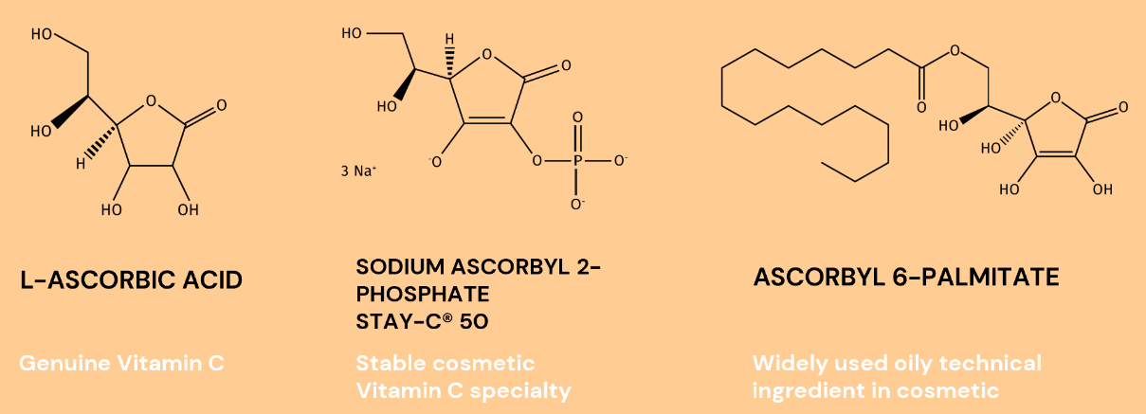
Vitamin C at a glance
Essential for our body, from external sources to support health
    Vitamin C is Ascorbic Acid in different forms
    Vital functions for life
    Humans are unable to synthesize Vitamin C and therefore rely entirely on external supplementation such as topical application
    Vitamin C is the most abundant anti-oxidant in the skin
    Exposure to oxidative stress via pollutants or UV irradiation provokes Vitamin C depletion in the epidermis
    Even high dose oral supplementation does not provide the sufficient amount of Vitamin C into the skin
        ➔ We need topical application with Vitamin C to afford skin benefits!

Slide 15
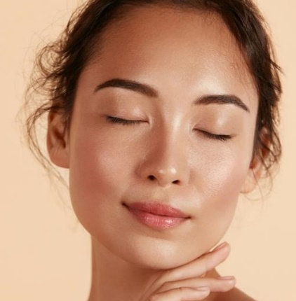
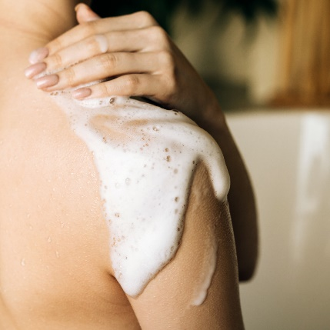

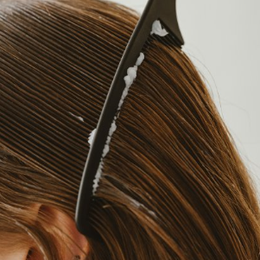
Vitamin C : benefits in Beauty & Care
SKIN CARE
BODY CARE
Stimulates collagen synthesis ^{1,2}
Improves skin firmness¹
Protects from environmental damage and premature aging ^{1,2}
Decreases melanin synthesis reducing hyperpigmentation ^{1,2}
​Improve appearance of acne-prone skin​ ^{1,2}
Enhances skin elasticity²
Shields against oxidative stress²
Evens skin tone^{1,2}
SUN CARE
Neutralizes the oxidative stress acting as radical scavenger​¹
Protects against UV- and ozone- induced oxidative damage​^{1,2,3}
Reduction of photodamage^{1,2}
HAIR CARE
Support hair care and promotes hair growth³
1. In vivo. 2. In vitro. 3. Ex vivo

Slide 16

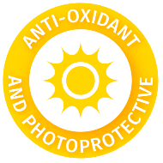
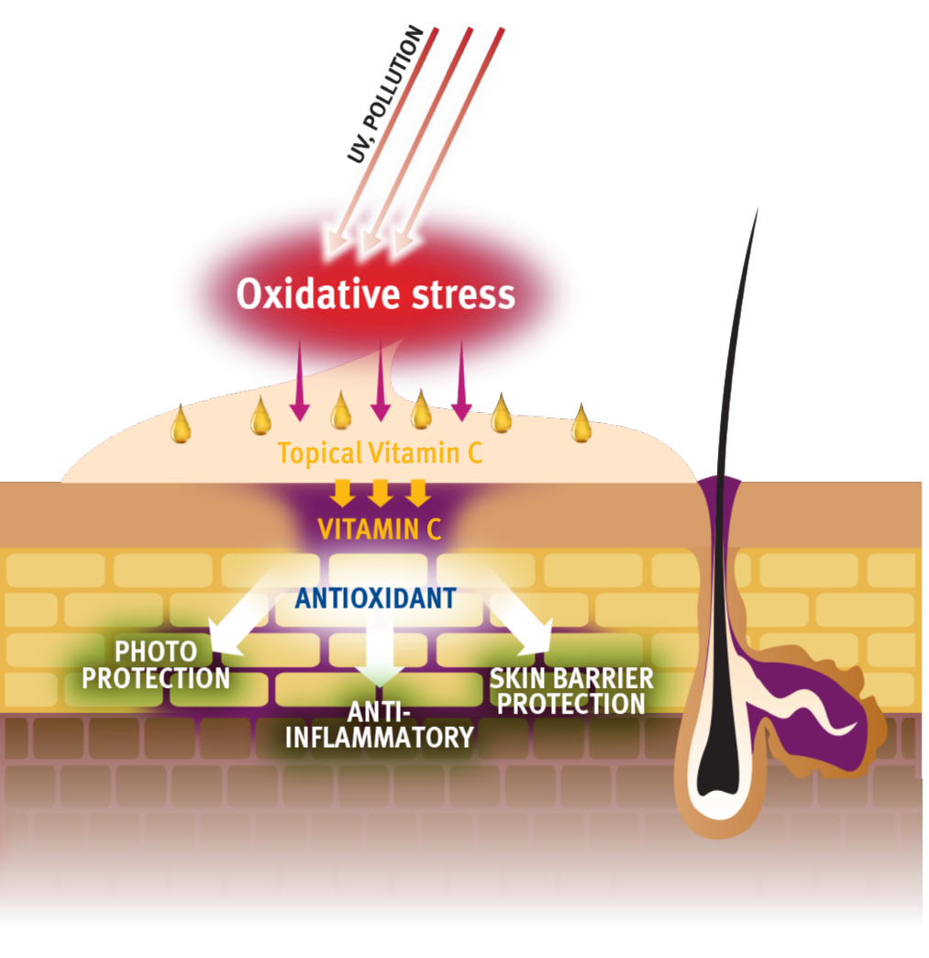
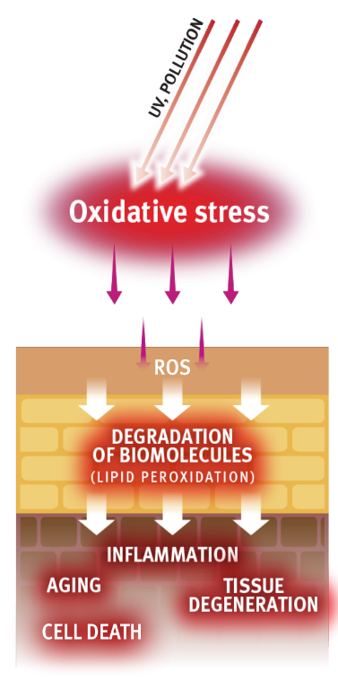
Vitamin C – N. 1 benchmark anti-oxidant
Vitamin C protects the skin against oxidative damage by neutralizing reactive oxygen species (ROS)
UV radiation, pollution and smoking accelerate damage to the skin through the generation of the “oxidative stress”
ROS are highly toxic, unstable molecules that cause damage to nucleic acids, proteins and lipids in cells
Vitamin C neutralizes the ROS generation by a process of electron transfer and/or donation and limits the propagation of the oxidative stress
Park. Biomol Ther 23(3), 207-217 (2015)

Slide 17
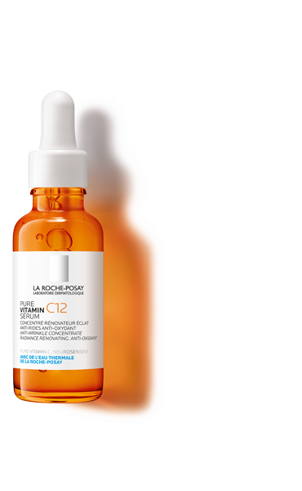
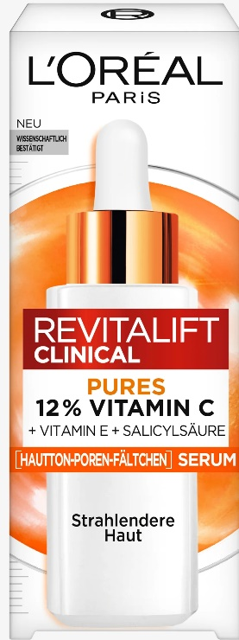
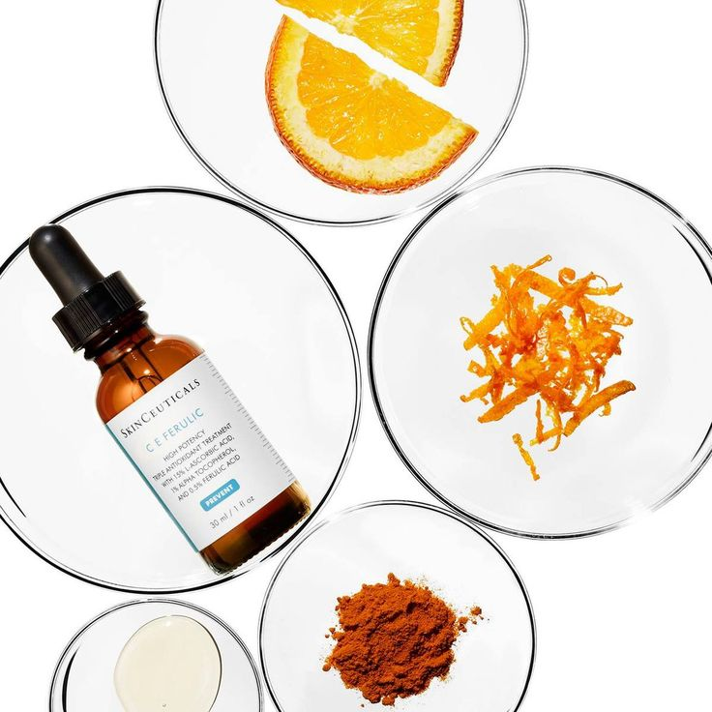
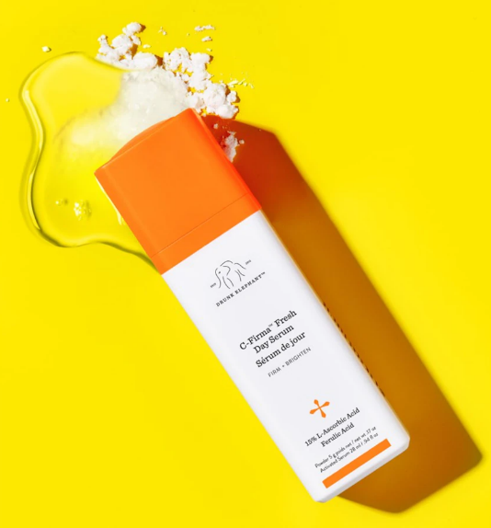
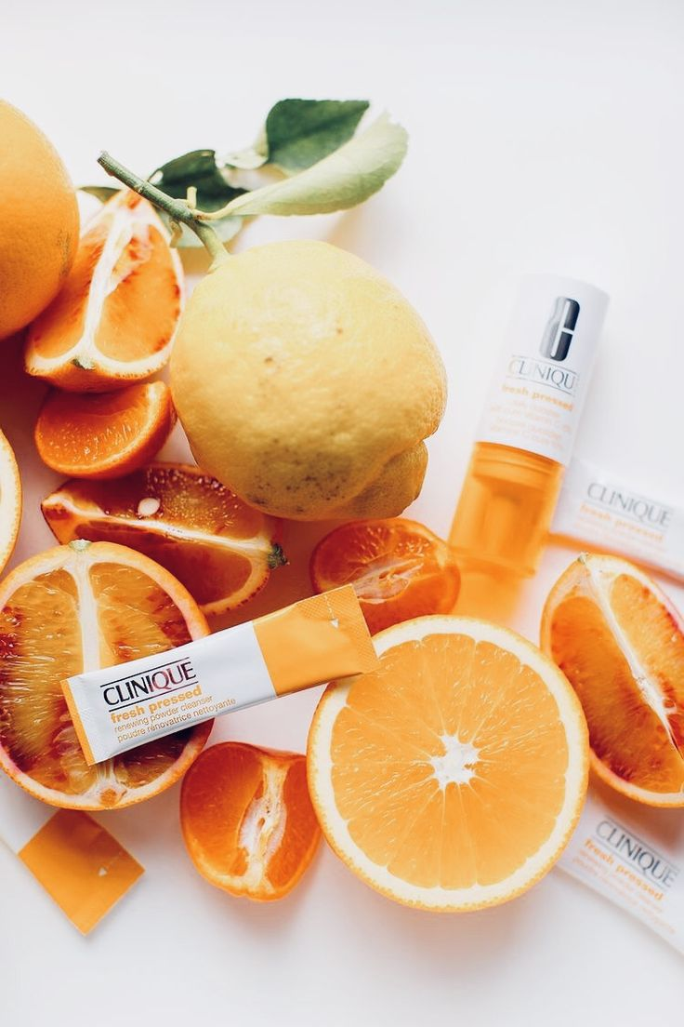
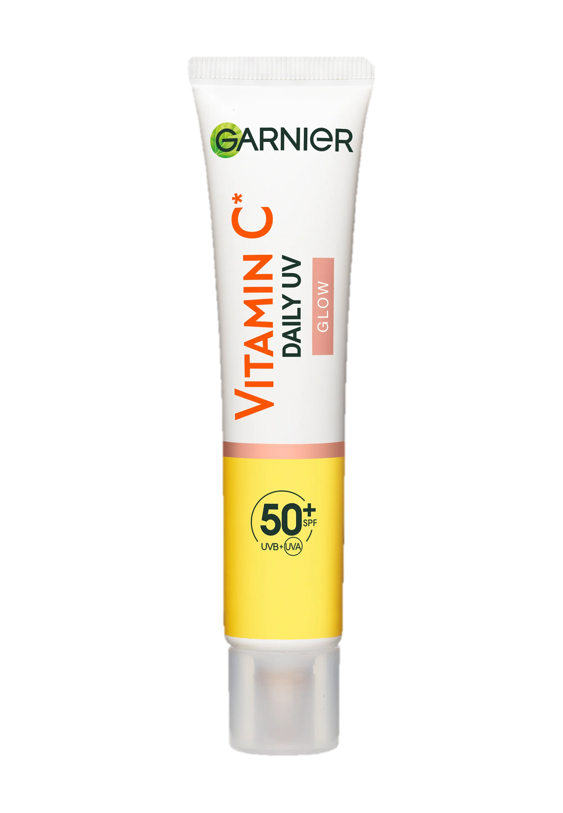
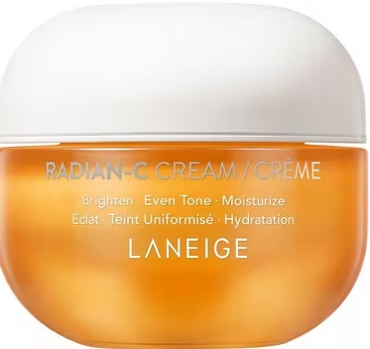
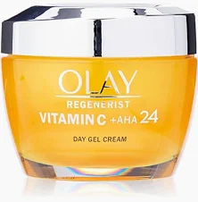
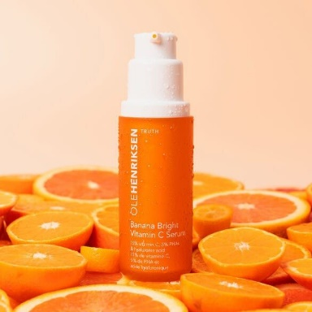
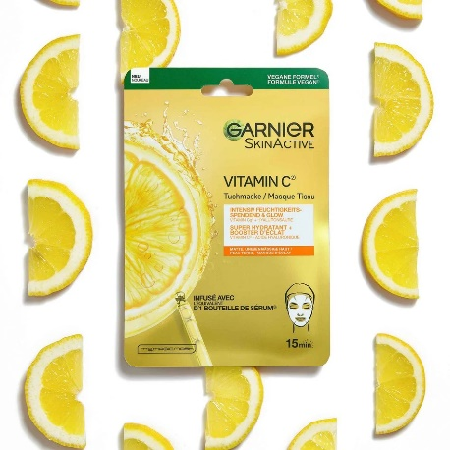
Vitamin C is still very trendy!​

Slide 18

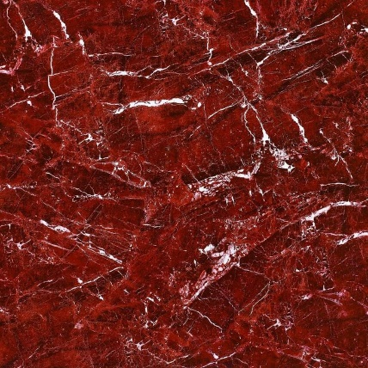


Different forms of Vitamin C
Advantages & Solutions
Pros
Cons
Solution
The only biological active form of Vitamin C is L-ascorbic acid!
Many other form of vitamin C must be converted into ascorbic acid in the skin
Water-soluble
Unstable at neutral and basic pH
Highly susceptible to oxidation
(water, light, air, heat)
Penetration into the skin depends
on formulation
To ensure better stability and skin penetration of Vitamin C,
different forms of L-ascorbic acid have been developed and launched on the market
18

Slide 19

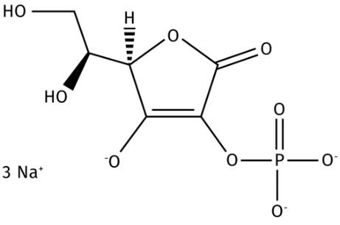
STAY-C® 50 : improved stability of Vitamin C
Our stable cosmetic Vitamin C specialty
  To ensure better stability of Vitamin C, dsm-firmenich developed STAY-C® 50: SODIUM ASCORBYL 2-PHOSPHATE
  - Stable, water soluble cosmetic Vitamin C specialty
- 100% naturally derived (based on renewable carbon)
- Fully bio-converted into ascorbic acid in the skin
- Powerful antioxidant and multi-talented active
    Benefits vs other derivatives​
    Good skin penetration
    Proven conversion into the active form ascorbic acid
    A multi-talent beauty remedy addressing almost every skin concern from acne to UV damage…and its activity is proven!
    Overperformance in melanin synthesis inhibition and antioxidant properties vs other derivatives
    Stable in aqueous environment
    Easy to formulate
    Only derivative with use level up to 15%
    Approved quasi-drug active ingredient for whitening products in Japan

Slide 20

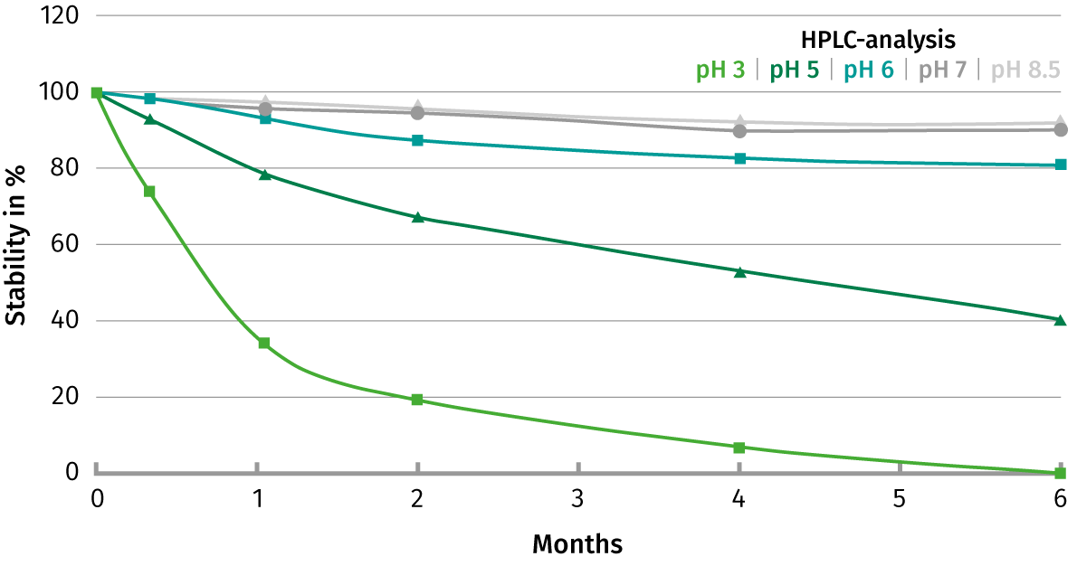
STAY-C® 50 – Stability in formulation
80 to 100% stable after 6 months in solution at pH ≥ 6
Stability of 3% STAY-C® 50 in water 43°C without light
STAY-C® 50 is highly stable at a pH of 6 and higher
Even at 43°C 90% of the STAY-C® 50 initial concentration has been detected after 6 months
DSM Internal study
Notes:
•The concentration of STAY-C® 50 was measured by HPLC.
Based on these results a pH below 6 should be avoided for long term stability to prevent degradation of STAY-C® 50.
A very good stability can be achieved by adjusting the pH at pH 6 or even higher.
•Formulations displayed in the study: Rapport final STAY-C 50 (REPORT No. 1004857)

Slide 21
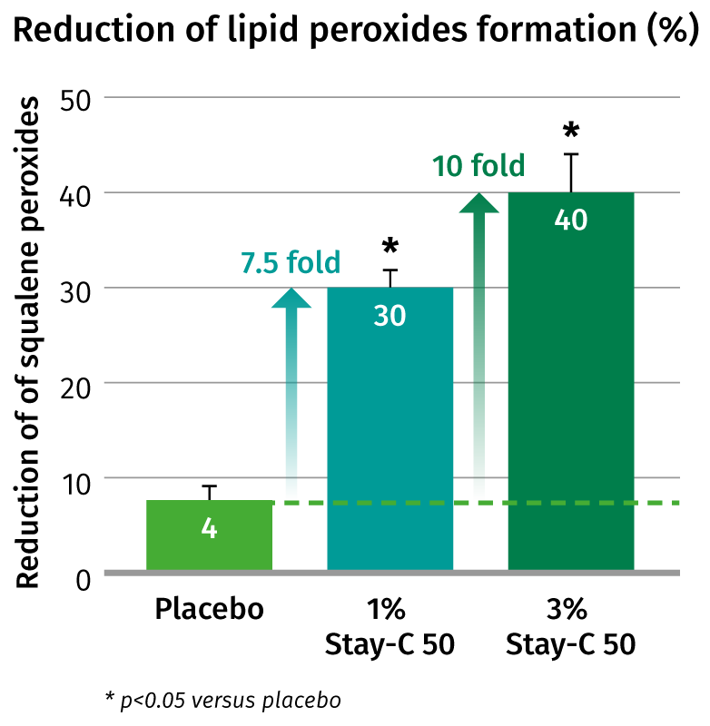
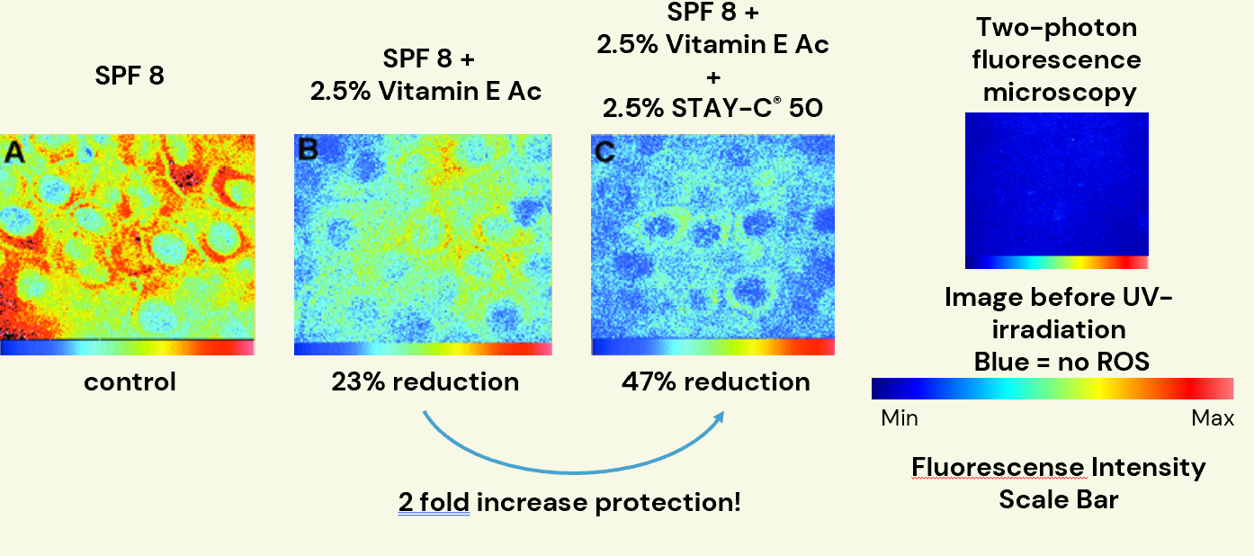
STAY-C® 50 – in photoprotection
in vivo
STAY-C® 50
reduces the UV-induced lipid peroxides up to 40%
STAY-C® 50 doubles the UVA/UVB protection of sun filters and Vitamin E
Image of live human skin showing the effect of three products on reduction of ROS after UV irradiation (1600J/m2)
    STAY-C® 50 significantly protects against the UV-
    induced formation of oxidized molecules in human
    skin in a dose-dependent way
20 volunteers
7 days prior UV-irradiation, twice daily
1% STAY-C® 50 or 3% STAY-C® 50 vs placebo
Ex vivo human skin (breast and facial), 2 individuals
Formulations applied for 3h
Park. Biomol Ther 23(3), 207-217 (2015)
Notes:
•Oxidative stress was induced by UV-A dose = 10 J/cm2
•The lipids present at the test area were harvested via solvent extraction method and finally analyzed for squalene and squalene hydroperoxide by HPLC
After 7 days of application (twice a day) the skin was
irradiated with 10J/cm2 UV-A light. Squalene and squalene
peroxide were quantified by HPLC and referred to untreated
skin after UV-irradiation.
•STAY-C ® 50 shows a significant reduction in lipid formation of 30% with a 1% STAY-C ® 50 formulation and 40% reduction with 3% STAY-C ® 50
This study was executed by Derma Consult, an outside institute in Germany.
The aim of this study was to evaluate the efficacy of the anti-free radical/ anti-oxidant active ingredient STAY-C® 50 following the exposure to low sub erythematous doses of UVA in the region close to MED.
The study has been targeted to the external layers of the stratum corneum, the body’s principal barrier to the environment.
Peroxidation of sebum squalene by UVA stress is used as parameter.
After a 7 days pre-treatment period the subjects’s back (age 18-39, 12 female, 8 male) was irradiated with UVA, two hours after the last daily application. The lipids present on the test areas were harvested via a solvent extraction. Squalene and squalene hydroperoxide were then analysed HPLC.

Slide 22
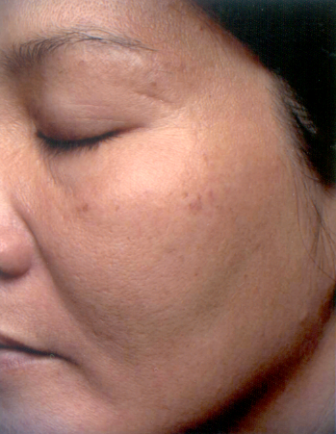
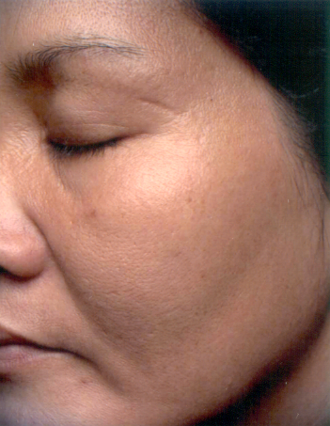
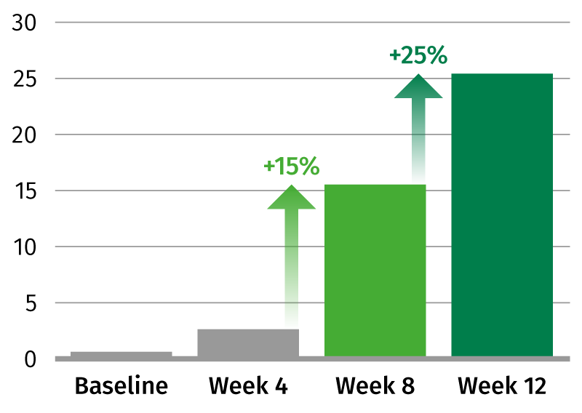
STAY-C® 50 – skin lightening activities
in vivo
Visibly evens the skin tone and reduces the color intensity of age spots
by 25% in 3 month
Quantification of improvement by visual assessment (dermatological evaluation)
Photographic evidence of spot reduction
After 12 weeks
STAY-C® 50
  Double blind study with half face treatment
  39 female volunteers
  Test cream with 3% STAY-C® 50 and 1% Vitamin E acetate
  12 weeks, twice daily application
Before
J. Klock. SÖFW-Journal | 130 | 9-2004 (no data report available)
Notes:
•30 to 45 years old
•Clinical evaluation and grading by dermatologists
•a 3-month in vivo study on Asian skin has shown that regular use of a cream with STAY-C® 50 resulted in a reduced color intensity of facial age spots. The overall skin lightening effect of STAY-C® 50 was assessed as 25% by dermatological reading
•Formulation SK-E-100097-123
•Report S123_006

Slide 23
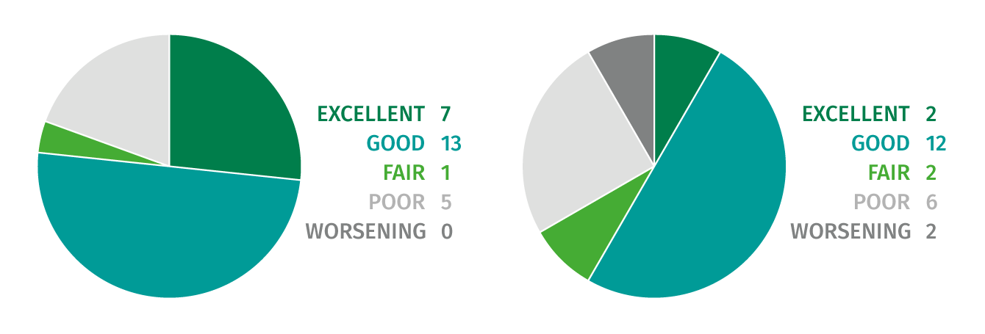
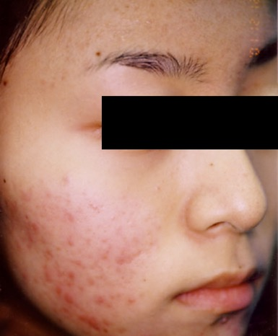
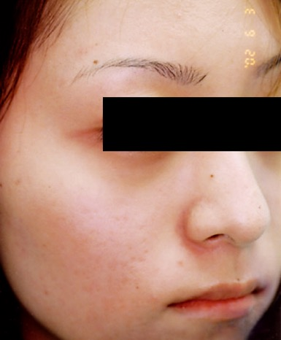
STAY-C® 50 – reduces the appearance of acne
in vivo
Visibly improves skin condition of acne vulgaris by 77 % in 12 weeks
Improvement of skin conditions after treatment
5% STAY-C® 50
5% Benzoyl Peroxide
77% excellent/good
61% excellent/good
  STAY-C® 50 visibly reduces the appearance of
  acne lesions in 12 weeks and outperforms Benzoyl Peroxide#
Before
After 12 weeks STAY-C® 50
  2x30 patients with acne vulgaris
  5% STAY-C® 50 or 5% Benzoyl Peroxide
  12-week treatment, twice daily application
Klock J et al. Int J Cosmet Sci 2005;27:171-176
# Benzoyl peroxide is a bactericidal powerful ingredient against acne
Notes:
•Measurement by CCD microscopic device
•Assessment by grading into 5 groups: excellent, good, fair, poor, worsening performed by the investigator based on CCD microscopic device which captures clinical digital photographs and microscopic images
Number of subjects who completed the study 26 for stay c and 23 for BP
•The formulation is displayed in the publication

Slide 24

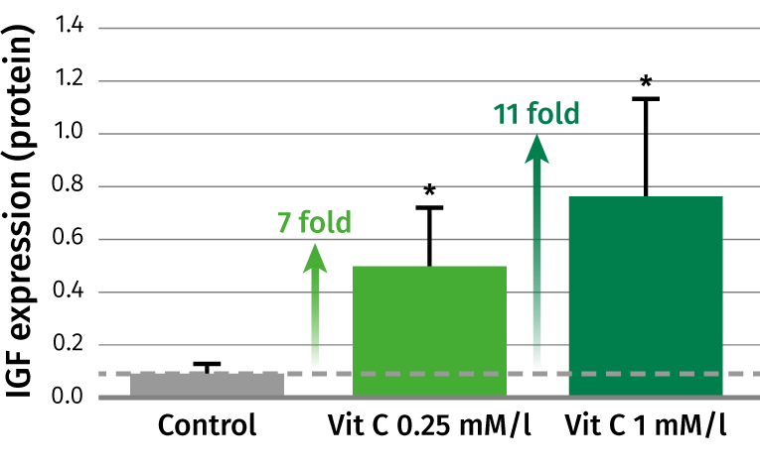
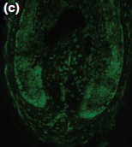
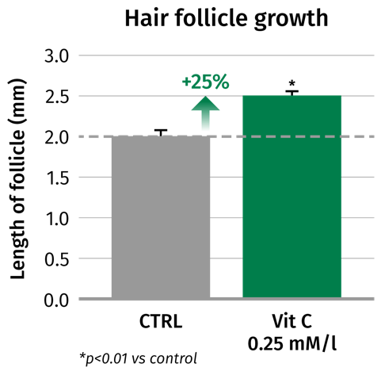
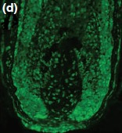
STAY-C® 50 – in hair care
ex vivo
Induces hair follicle growth up to 25%
  STAY-C® 50 stimulated the growth of cultured
  human hair follicle by upregulating IGF-1 up to 11-fold
Insulin-line growth factor-1 (IGF1)
expression in hair follicle
  Human hair follicles obtained from scalp biopsies
  Vitamin C #,0.25 and 1 mM/l, 9 days
CTRL
IGF expression
Vit C
IGF expression
Kwack MH et al. Br J Dermatol. 2009 Jun;160(6):1157-62.
# L-Ascorbic acid 2-phosphate
Notes:
•The concentrations of IGF-1 in conditioned media were measured by ELISA. Gene expression was analysed by RT PCR
•Isolated human hair follicles incubated in the absence (c) or presence(d) of 0.25 and 1 mM/L of Vitamin C for 12 h and immuno-stained with polyclonal antibodies against IGF1
The stimulation of IGF1 is important to counteract the thinning of hair and a slow hair growth as reported recently (Trueb. Skin Appendage Disord. 2018 Apr;4(2):90-95)"

Slide 25

Formulating with STAY-C® 50
Stability
pH ≥ 6
Add 0.05-0.1% Sodium Metabisulfite to improve color stability
Add chelating agents (EDTA, phytic acid, etc..) to prevent degradation
Check stability with acrylic acid thickeners and some ionic emulsifiers
Solubility
Readily soluble in water
Insoluble in lipophilic comp. or alcohols

Slide 26


Formulating with Ascorbic Acid
Stability
Low pH (3-4)
Low water content (adding alcohol, glycols, etc..) or anhydrous formulations oil-/silicone-based
Antioxidants (Tocopherol,… etc..)
Packing (airless)
Solubility
Freely soluble in water
Sparingly soluble in alcohol
Soluble in glycols

Slide 27
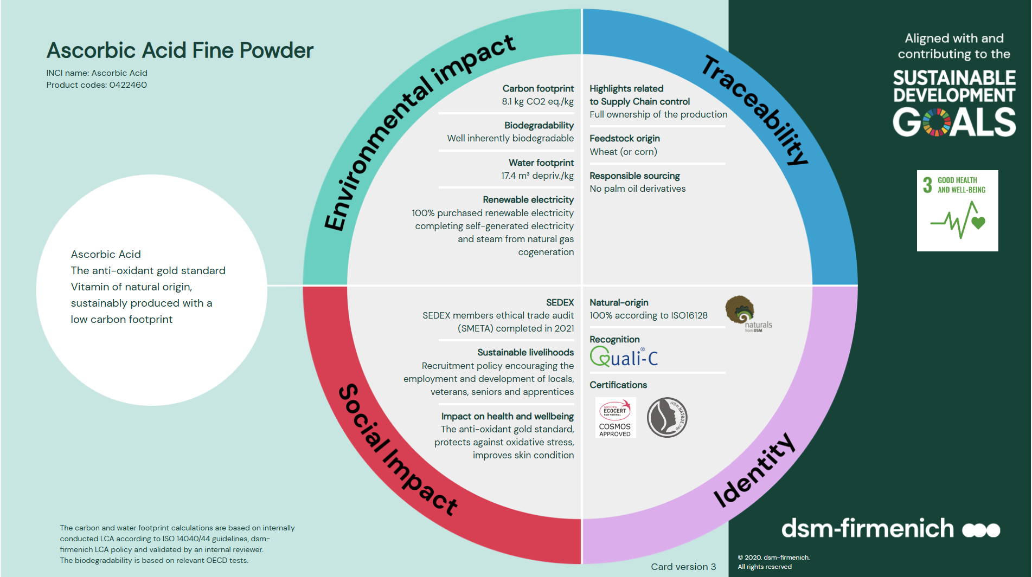

Slide 28
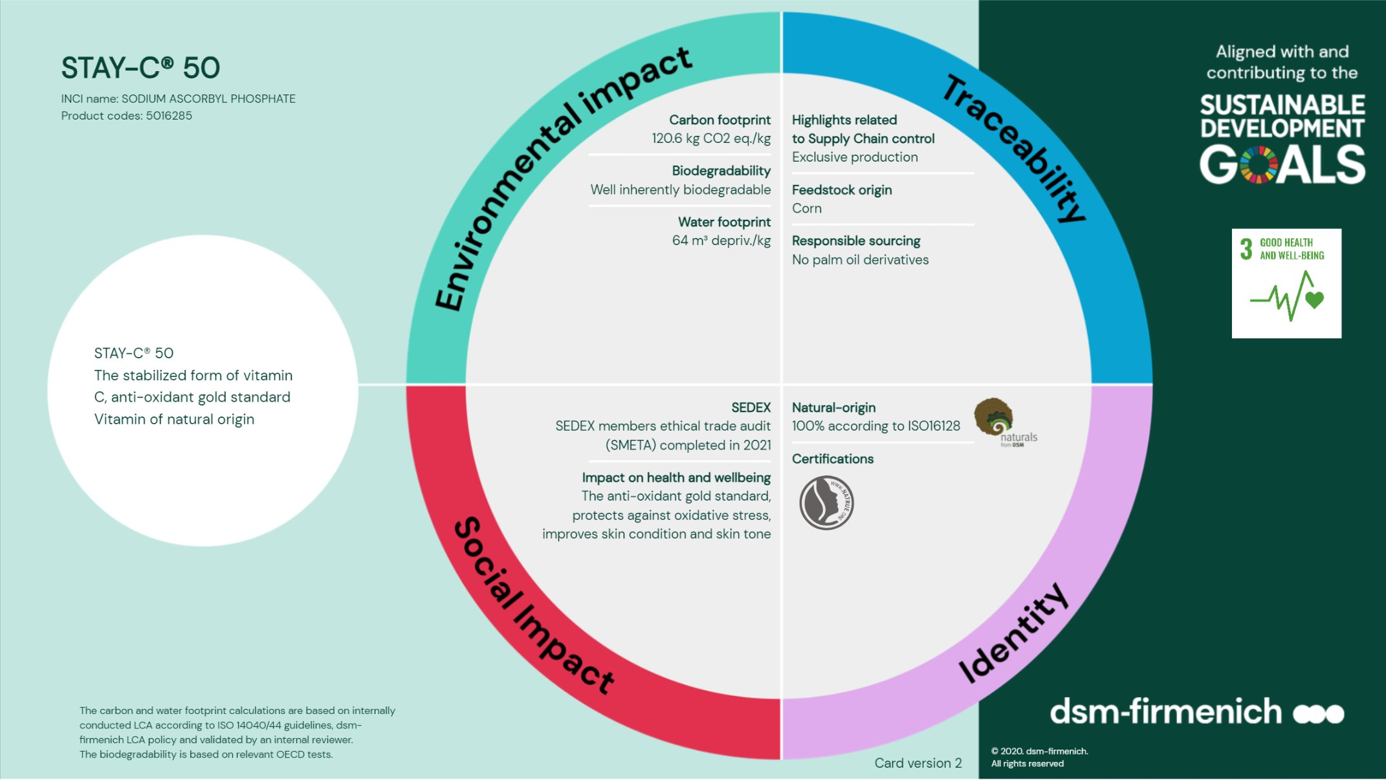

Slide 29


Slide 30




Niacinamide PC
The multi-purpose Vitamin
Niacinamide (Vitamin B3) is a very stable vitamin which offers
a wide range of well-documented topical benefits.
Niacinamide improves skin health by strengthening the skin barrier, minimizing the appearance of pores, evening out skin tone, and protecting against environmental stress.
Niacinamide is a key component of NAD+ and NADP, essential coenzymes in ATP production, also having a central role in DNA repair and skin homeostasis.
What is special about Niacinamide PC?
Niacinamide PC is a special cosmetic proprietary grade of DSM,
which has a low guaranteed level of residual nicotinic acid to
address any concerns about unpleasant skin sensations.
Fully raw material backward integrated
(picoline – intermediates of niacinamide- from natural origin, ex tapioca)
An all-round product for my skin?
Niacinamide PC is the ideal candidate for day care and sun care products.
Suitable for all skin types and well tolerated.

Slide 31
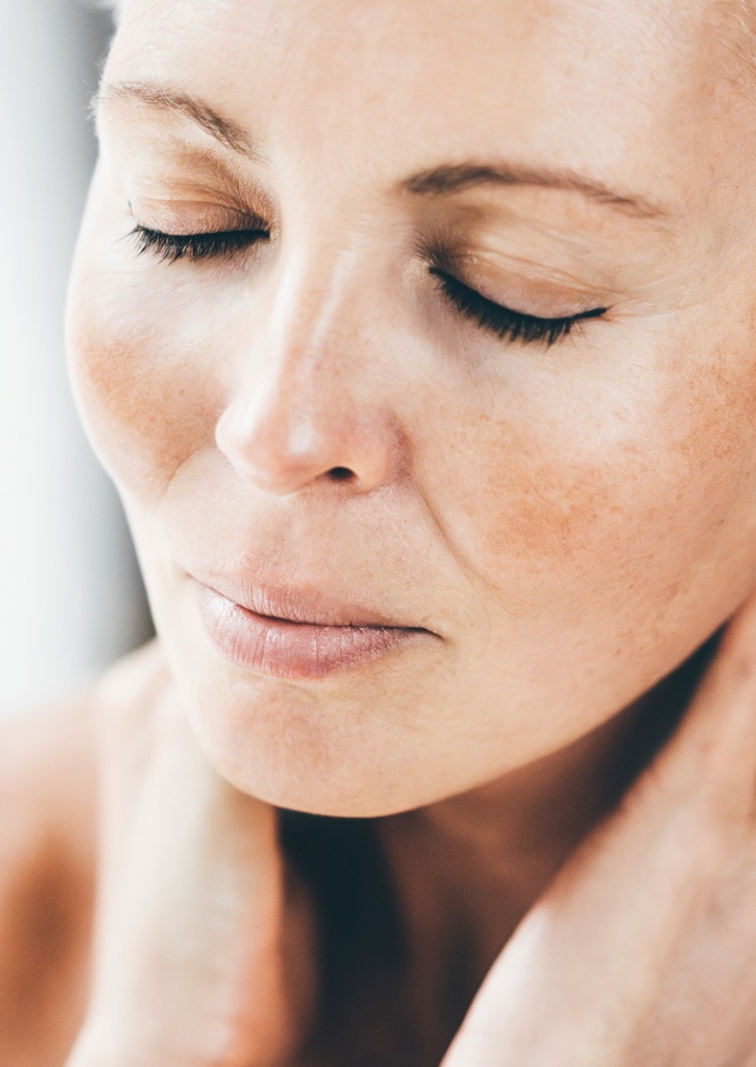





Niacinamide PC: proven benefits
Resilient, flawless skin and radiant complexion
CORNEOCARE® - Skin Resilience
Strengthens the skin barrier and stimulates and rebalances ceramides and lipids in stratum corneum¹
Increases key skin barrier proteins: involucrin, filaggrin, keratin²
Environmental stress protection
Boost cell energy production and repair (UV induced DNA damage)^{2,3}
Protection against urban pollutants, UV and blue light related premature aging damage^{1,2,3}
Even skin tone
Inhibition of melanosome transfer²
Rebalances uneven skin tone^{1,3}
Blemish Care
Reduces the appearance of acne¹
Helps to reduce sebum level¹
Anti-aging activities
Stimulates and protects collagen ^{1,2}
Improves the appearance of lines, wrinkles and skin elasticity¹
1. In vivo. 2. In vitro. 3. Ex vivo
Notes:
Niacinamide: multi-purpose solution. Now also for Menopausal skin.

Slide 32


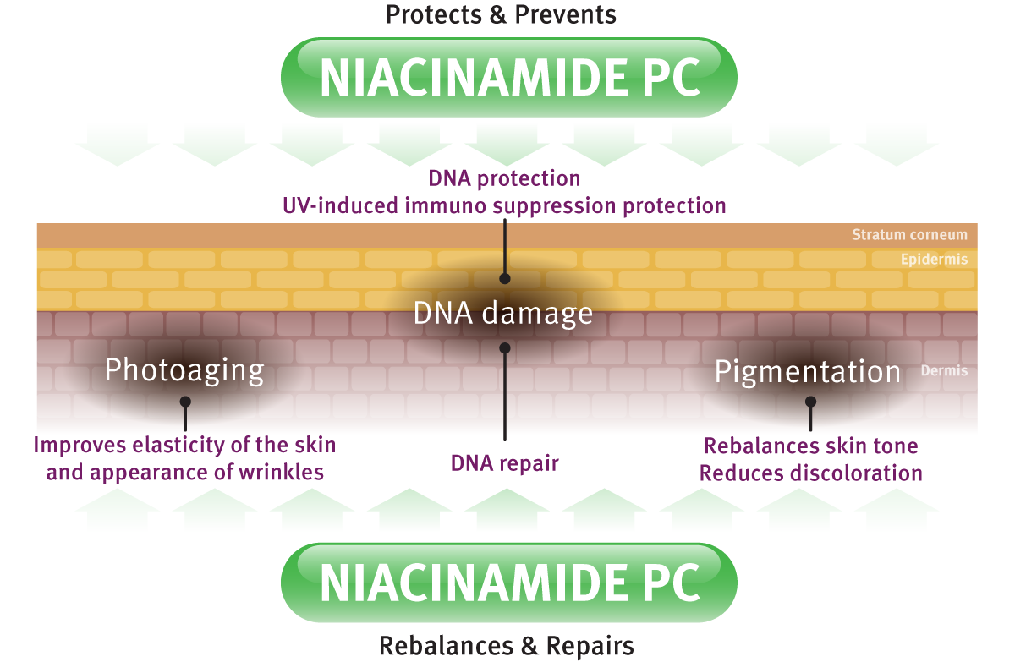

Environmental stressed Skin Care
Protection & Repair
UV
Blue-light
Pollution
Oxidative stress
Notes:
Exposure to sun light act together with the normal aging process to prematurely age our skin. UV radiations are also triggering excessive or uneven skin pigmentation as well as skin cancer development. The mechanisms by which UV leads to cancer are complex including direct damage to DNA and effects on the immune system. Niacinamide showed to be effective in tackling UV damage: from protecting and repairing UV stressed skin to maintain its beautiful glow and elasticity

Slide 33
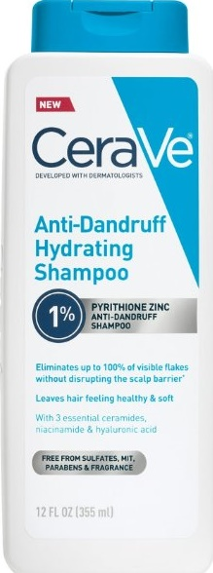
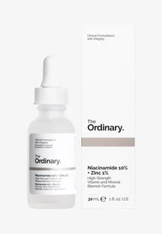
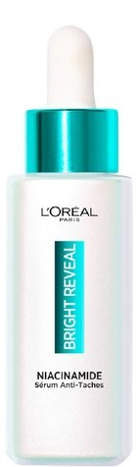
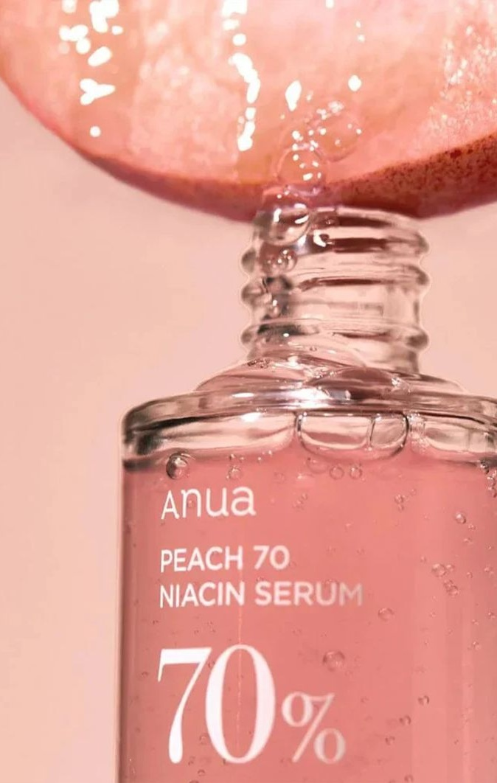
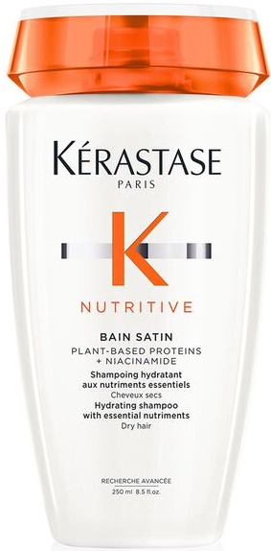
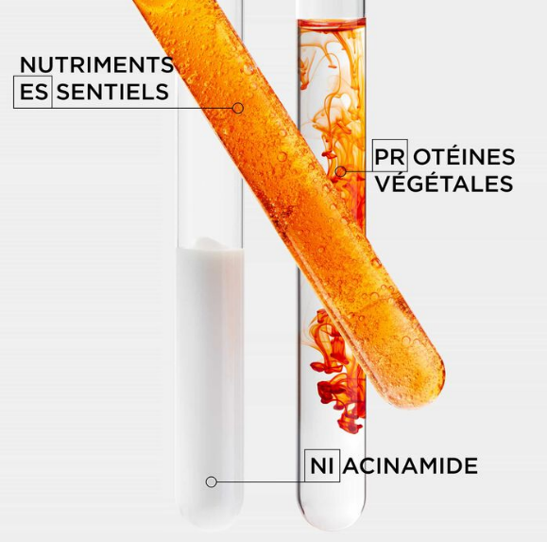

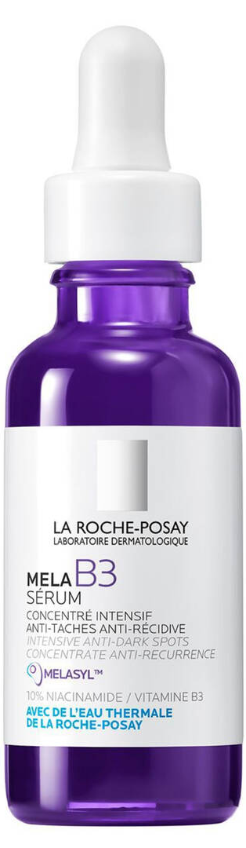
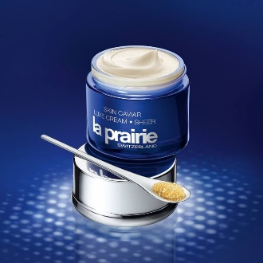




Niacinamide is everywhere
A key ingredient in B&C, and at L'Oréal
Niacinamide doubled its usage, from 10% to 20% penetration, in only 5 years.*
*[Mintel search years 2020-2025]

Slide 34







From taboo to trending topic:
Personal care innovations to be more inclusive on menopause
According to 2021 data from Grandview Research, the global menopause cosmetics market size will reach $22.7 billion by 2028.
Neovadiol by Vichy is a line of cosmetics designed to reduce visible signs of post-menopausal skin aging. Backed by dermatological tests and endorsed by experts in the field, Neovadiol offers targeted solutions for menopausal skin care.
Product launches incl. menopause claim increase from 2018 to 2023 by 35 folds, and +24% from 2022 to 2023.
Source: Mintel, gnpd.
No. 7 Menopause Skincare line specially developed to target fine lines and wrinkles. Dermatologically tested and approved by dermatologists with expertise in menopausal skincare.
Pantene Pro V Hair Biology Menopause: a range to help manage the changes brought about by age and hormone imbalance.
Notes:
Source: trendwatching.com
A menopause-focused health company announced in February 2022 that it has extended its partnership with the UK’s NHS to help expand its digital clinic for women’s health. Bia Care was the first of its kind to partner with the NHS in 2021; additional funding will allow the company to expand the availability of its digitally-enabled women’s health clinic. Bia Care connects women to menopause specialist doctors using group consultations, which improves the doctor to patient ratio and means up to six times more patients are treated. Results from the NHS pilot trial showed that the service model delivered clinically effective services at a fraction of the cost of a traditional menopause clinic. https://linktr.ee/biacare
In August 2021, France-based L’Oréal partnered with period-tracking app Clue to research how the skin is affected by the menstrual cycle. With over 12 million users in 190 countries, Clue will deploy voluntary surveys to be studied by L’Oréal’s research and development teams and Active Cosmetic Division. L’Oréal will share its findings in Clue’s reproductive health encyclopedia, found on Clue’s website, and hopes to develop science-backed personalized skincare routines that take into account menstrual cycles from puberty to menopause. Clue is based in Germany.
France-based skincare brand Vichy is aiming to alleviate the stigma surrounding working women’s menopause. In partnership with Allbright, a club created by women, for women, Vichy hosted Let’s not Pause for two days in May 2021. The virtual summit discussed the impact of menopause on working women’s lives, ways to address under-reporting of the topic, and how businesses can be demystified to its influence. Four women hosted the panel, sharing details of their experiences.
In Arabic, menopause literally translates as “the age of despair”. Upon discovering that 81% of Saudi Arabian women believe the phrase needed changing, the incontinence brand Tena launched a video campaign with the hashtag #DespairNoMore. The video depicts women sharing their positive experiences of menopause in a bid to destigmatize it and, ultimately, eradicate the Arabic translation for good. Consumers are invited to share their suggestions for a replacement phrase via Tena’s website.
Womaness is a consumer products brand created to serve the needs of women at all stages of the menopause. In Q1 2021 it launched its first range of products at US supermarket giant, Target. The products include a dietary supplement, a sexual wellness kit, and cosmetics designed to target menopause-induced skincare issues, with prices starting at USD 8.99 for a packet of sanitary towels. The brand’s overarching aim is to promote ‘menopositivity’ and to address the needs of a largely underserved demographic.
August 2020 saw UK-headquartered beauty brand Avon announce the launch of adapt Sync: a skincare collection for women experiencing menopause and perimenopause. The range was created in response to Avon’s Too Little Information report, which revealed approximately 44% of women globally were unaware of perimenopause and the effects on the body. Offering holistic solutions for menopausal skin issues, the collection is formulated with soothing botanical adaptogens, such as turmeric, with anti-inflammatory and antioxidant properties, and Avon’s patented tiliacora, helping to cool the skin and increase hydration and firmness. Included in the range, which are an Icy Cooling Elixir Facial Mist, Dream Cream Night Cream and Hydra Rescue On The Go Serum.

Slide 35
The multi-functional vitamin for menopausal skin changes
Niacinamide PC
The multi-change stage of menopausal skin aligns well with the multi-benefit properties of Niacinamide, making it an excellent ingredient for counteracting the skin effects of menopausal hormonal changes.
The new in vivo study from dsm-firmenich shows that Niacinamide PC is an effective solution for menopausal skin concerns. It addresses issues such as dryness, sensitivity, fine lines, wrinkles by strengthening the skin barrier and protecting against collagen degradation. Its DNA repair properties and ability to fade hyperpigmentation make Niacinamide PC ideal for menopausal women skincare routines, enhancing overall skin health and resilience during this multi-change period.
Niacinamide PC strengthen the scalp barrier while keeping it hydrated, providing comprehensive care for scalp and healthy hair.
A naturally-derived and sustainable grade of Niacinamide PC.

Slide 36
Multipurpose vitamin for multiple skin changes during menopause
Niacinamide: the versatile vitamin
Menopause skin changes
What happens in the skin
Niacinamide Treatment
Epidermal barrier dysfunction
Loss of hydration
Different distribution of Ceramides
Hydration
TEWL
Re-balance ceramides composition to pre-menopausal level
Restores hydration
Reinforces Epidermal barrier
Skin homeostasis and NMF disruption: release of imidazole compounds
Sensitive skin
Helps to relieve sensitive skin
Reduced energy availability
NAD+¹
Supports cellular energy metabolism
Slower skin repair ability
DNA protection and repair
Cytosine level (marker of DNA protection)
Enhances skin repair
Reduced skin elasticity,
promotes wrinkles
Collagen protection
Free proline (marker of collagen degradation)
Collagen production
Boosts skin elasticity,
reduced wrinkles
Upregulating histidine degradation (marker of skin homeostasis disruption): release of markers of UV skin damage
Increased UV induced skin damage and photoaging effects
Protects against UV-induced skin damage and photoaging
1: NAD+ oxidized form of Nicotinamide Adenine Dinucleotide

Slide 37



New Science on Niacinamide in post-menopausal skin
New
in vivo study
Re-balancing of Ceramides​
Protection against Collagen degradation
Skin Hydration
Menopausal skin is subject to different ceramides' composition compared to pre-menopausal skin.​ Niacinamide PC treatment boost all endogenous ceramides (with highest increase arond 30%, restoring the native distribution of pre-menopausal levels of different ceramide types in the skin, much better than with topical application
Collagen synthesis is generally reduced during menopause. Treatment with Niacinamide PC resulted in lower levels of free proline and acetyl-proline, confirming its effectiveness in preserving collagen integrity and maintaining skin elasticity.
Due to hormonal changes menopausal skin tends to become drier, giving the skin an itchy feeling. High level of Niacinamide is correlated with reduced trans epidermal water loss (TEWL) and consequent increase of skin hydration.
Relative content of ceramides and % change pre- vs post Menopause and by Niacinamide PC treatment
Free proline content
Skin hydration by cutometer
Niacinamide PC rebalances the ceramide distribution
Significant increase of free proline by 80% and significant reduction of free proline by 24% after treatment by 5% Niacinamide PC vs placebo
Significant increase of skin hydration by 22% vs T0 and by 13% vs Post Menopause group

Slide 38



New Science on Niacinamide in post-menopausal skin
New
in vivo study
DNA Repair
Photoprotection
Energy Boosting
Post-menopausal skin is prone to DNA damage and more subject to UV-induced DNA damage compared to pre-menopausal skin. Treatment with Niacinamide PC shows significant increase of cytosine level (+244%), confirming the ability of Vitamin B3 to enhance DNA repair.
UV-stress markers such as cis-urocanic acid can be found at increased level in post-menopausal skin. Treatment with Niacinamide PC show a decrease of 28% in cis-urocanic acid content vs placebo. By promoting different catabolic pathways, Niacinamide PC provides biological protection from UV damage in postmenopausal skin.
NAD+ is a key molecule of cellular energy metabolism, and it appears to be in lower level in aged skin. As precursor of NAD+, Niacinamide is a building block to boost energy production at cellular level.
Cytosine level before and after treatment
Cis-urocanic acid
Simplified pathway of cellular energy production
(ATP production) with niacinamide and NAD+

Slide 39
Formulating Niacinamide PC
Niacinamide PC is very stable (air, heat, light)
and easy to formulate with.
Highly soluble in water and alcohol and soluble
in glycerol.
Niacinamide PC shows a very good compatibility
with all groups of cosmetic ingredients
Niacinamide PC can be processed either cold or hot at temperatures up to 70°C . Generally added in the aqueous phase of a cosmetic formulation
Caution: Niacinamide PC is incompatible with strong acids and bases and oxidizing agents which may cause hydrolysis to nicotinic acid. It is important to not use ingredients containing enzymes such as amidases to avoid biological hydrolysis of niacinamide to nicotinic acid
Recommended pH of the final formulation: 4.0 – 8.0
Suggested dosage : 1 to 7%

Slide 40


Slide 41


Slide 42






Vitamin B12
The biotech pink vitamin
for sensitive and stressed skin
Unique Product Features
Biotech naturally derived pink vitamin
Active on atopic dermatitis, reducing erythema and pruritus in vivo
Prevents inflammation ex vivo: significant and strong reduction of inflammasome and inflammatory cytokines such IL1-ß.
Epigenetic regulation of inflammasome: over-expression by 61% of miR-22-3p with vitamin B12 leads to a reduction of inflammasome ex vivo
Significantly reduction of Mast cell degranulation by 27%, drops the histamine release in vitro
Maintains healthy skin microbiome, by reducing pathogenic S. aureus vs beneficial bacteria in vitro

Slide 43

Vitamin B12
Soothes and regenerates sensitive skin, making it look more vibrant
Consumer benefits
Vitamin B12 relieves sensitive and stressed skin
Dermatological treatments for skin conditions like itchy, dry, inflamed, red and cracked skin
Helps prevent photo-damaged skin
Protects the skin barrier damage induced by inflammation
Plays an important part in speeding up cell recovery and regeneration
Skin looks more vibrant
Nice pink color of the formulations

Slide 44














Vitamin B12 is gaining traction
Continuous growth of total of launches containing Cyanocobalamin where Asia is the leading region followed by Europe. The application most used is face care.​

Slide 45



dsm-firmenich scientists discovered the action of Vitamin B12 on the inflammasome
NEW
Vitamin B12 reduces UV-B induced inflammasome reaction ex vivo
Vitamin B12 significantly up regulates by 61%
miR-22-3p at 0.01%
miR-22-3p expression after UV stress
Vitamin B12 significantly down regulates ASC complex activation by 100%, to the level of non-treated, at 0.01% after UV-B stress
Mean ASC intensity
UV, pollution, bacterial invasion or any oxidative stress induce the formation of the inflammasome, especially in keratinocyte.
Its components are pro-Caspase-1, ASC and NLRP3 which is regulated by the epigenetic factor miRNA 22-3p.
If it gets chronically activated, it causes skin irritation, skin tissue damage and premature aging
45

Slide 46


First discovery: Vitamin B12 reduces histamin by inhibiting mast cell degranulation in vitro
NEW
Degranulation rate
No degranulation occurred
Vitamin B12 significantly inhibits mast cell degranulation by 31% at 0.00015%.
It helps to protect inflammation induced skin barrier damage and relieves sensitive and irritated skin
Degranulation
*** p-value<0.001
Mast cells can be activated by environmental stress factors like allergens, UV light, pollution and free radicals.
Degranulation is the release of pro-inflammatory mediators such as histamine, cytokines, proteases,…leading to itching, stinging, burning, redness, dry and sensitive skin
46

Slide 47




Formulating Vitamin B12
Easy-to-use
Sparingly soluble in water, slightly soluble in ethanol, insoluble in lipophilic components
Can be used for different kinds of leave-on and rinse-off products like O/W, W/O or W/Si formulations, cream gel, clear gel, shower gel, shampoo, body wash
To be incorporated into the aqueous phase at any time (<80°C)
Is sensitive to high temperature storage and day light. It is recommended to add a chelating agent (such as sodium phytate, Etidronic Acid, Disodium EDTA). For better stability at 50°C sodium gluconate or glycine could be added
Recommended pH of the final formulation: 3.5–7.5
Perfectly fitting to any natural formulations
Use level: 0.001–0.1%
C₆₃H₈₈CoN₁₄O₁₄P
Vitamin B12 cryst In O/W emulsion
0%
0.001%
0.005%
0.01%
0.02%
0.03%
0.04%
0.05%
Vitamin B12 cryst in water solution

Slide 48


Slide 49


Slide 50




D-Panthenol is pro-vitamin B5!
D-Panthenol (or Dexpanthenol) is the provitamin of D-Pantothenic acid, identified in 1933 in liver and yeast.
D-Panthotenic acid is Vitamin B5, a water-soluble vitamin.
Its name originates from the Greek word ‘pantos’, meaning ‘everywhere’, as it naturally occurs in foods and plants as well as throughout all living cells.
The human body converts D-Panthenol to Vitamin B5.
D-Panthenol
PRO-VITAMIN B5
D-Pantothenic acid
VITAMIN B5

Slide 51
Panthenol / Pro-Vitamin B5 : Benefits in Beauty & Care
SKIN CARE
BODY CARE
Improves skin hydration
Rejuvenates the skin by promoting cell stemness
Soothes irritated skin reducing itching, redness and inflammation
Promotes wound healing, stimulates epithelization
Softens body skin
(moisturizing effect)
Brings relief and regenerates damaged skin (burns, scars)
SUN CARE
Keeps skin hydration after UV stress
HAIR CARE
Long lasting moisturization
Prevents hair damage
Strengthens the hair
Gives shine
1. In vivo. 2. In vitro. 3. Ex vivo
Notes:
Panthenol, is valued in skin and hair care for its moisturizing properties. Because it is hygroscopic, panthenol acts as a humectant for hair. It adheres strongly to the cuticle and penetrates deep into the cortex of the hair shaft, thus improving the resistance of hair to mechanical stress.
However, the influence of panthenol on the epithelialization process together with its anti-inflammatory properties also make it ideal for soothing sensitive or irritated skin.

Slide 52













Panthenol is the gold standard of moisturizers
Panthenol is primarily found in hair care, but its presence in skin care is equally impressive.
Market penetration 2025: haircare >30% and skin care 20%*
*[Mintel search years 2020-2025]

Slide 53




Dry Skin is the 1st unmet need in term of Skin Care
Chinese women claim to have the driest skin
65% of
Chinese
women
53% of
American
women
scored between 7-10 on the dry skin scale
Moisturizing claims are by far the most popular functional claims in face/neck care
DSM survey 2014 *Global Total- N= 468 US- N= 155 Brazil N= 156 China- N= 157 + Mintel search

Slide 54



CORNEOCARE™ : Moisturization – Skin barrier on healthy skin
in vivo study
Water Content (U.A.)
Panthenol significantly enhances the water content of the healthy stratum corneum by 14% and decreases transepidermal water loss by 34%
Panthenol maintains the hydration of healthy skin
and protects the skin barrier
∗ p < 0.001 vs control group
TEWL (g/m².h)
  40 healthy female subjects, forearm, 20-35 years old
  0.5%, 1.0%, or 5.0% (w/w) D-panthenol formulation vs placebo
  15 and 30 days, twice daily
F.B. Camargo, L.R. Gaspar, P.M.B.G. Maia Campos. J. Cosmet. Sci., 2011, 62, 361–369
* p < 0.001 vs control group
Notes:
This device determines the water content of the superficial epidermal layers down to a depth of about 0.1 mm and expresses the values obtained in arbitrary units.
The averaged values of twenty measurements were used for subsequent calculations.
1% panthenol added to a basic formulation was sufficient to showed improvement of skin barrier function.
It is concluded that skin integrity is maintained by the improved protective effect of 1% panthenol added to the formulation.
Corneometer® measurements. The stratum corneum moisture content was determined with a noninvasive, skin capacitance meter (Corneometer® CM 825, Courage + Khazaka, Cologne, Germany), which makes use of the relatively high dielectric constant of water (22). This device determines the water content of the superficial epidermal layers down to a depth of about 0.1 mm and expresses the values obtained in arbitrary units.
The Tewameter® is based on Fick’s diffusion law, indicating the quantity being transported per a def ned area and period of time. By using the data obtained from thermo and hydro-sensors, and after processing the information by an inbuilt microprocessor, a numerical value of the TEWL is obtained, commonly shown in g/m2/h (14,23).

Slide 55


Skin Repair
in vivo study
Panthenol improves the cosmetic appearance of wound by 37% after 2 days compared to baseline
Panthenol leads to faster closure, re-epithelialization and better cosmetic appearance of wounds after fractional ablative CO2 laser resurfacing of photodamaged skin
  38 subjects with photodamaged skin
  7 days, once daily
  wound area in two sections: D-panthenol ointment (Bepanthen® Wound Healing Ointment, Bayer, Leverkusen,Germany) vs petroleum
  jelly (Vaseline)
Heise R, et al. Cutan Ocul Toxicol 2019
Notes:
38 patients with photo-damaged skin who received CO2 laser treatment. ablative fractional CO2 laser has become the gold standard in the treatment of photo-damaged skin.
Occlusive wound care was conducted for a period of 7 days. This study had three primary outcome measures: (1) Overview images as well as dermatoscopic images of the laser treated skin were taken immediately after laser treatment and on days 1, 2, 5 and 14 (study visits). Dermatoscopic images were analysed to determine changes of the diameter of the individual lesions between the study visits. (2) Wound-healing rate was visually assessed, based on the measure of re-epithelialization.
Cosmetic results were evaluated during study visits by patients and physicians applying a visual analogue scale (VAS).
Evaluation of the wound healing was performed by measuring laser lesions with digital dermoscopy.
Moreover, wound healing was evaluated by the clinical investigator on days 1, 2, 5 and 14 after laser surgery according to the degree of re-epithelization.
An evaluation of the cosmetic result was independently performed by the clinical investigator and the patient on days 1, 2, 5 and 14 after laser surgery using visual analogue scale (VAS).
The wound healing rates were assessed visually based on the degree of re-epithelialization, i.e. the percentage of newly formed epithelial tissue after tissue loss. The following score according to Wiggert-Alberti et al. 11 was given:
0% ¼ no wound healing
1–25% re-epithelialization
26–50% re-epithelialization
51–75% re-epithelialization
over 75% re-epithelialization
100% completed wound healing
Petroleum jelly application (VASELIN!) is the routinely used treatment for treating wounds after following CO2 laser therapy.
These results emphasize that the use of a dexpanthenol-containing ointment could be a promising alternative!
Petroleum jelly (Caelo weißes Vaselin, Caesar & Loretz GmbH, Hilden, Germany)
Dexpanthenol-containing ointment (BepanthenVR Wound Healing Ointment, Bayer, Leverkusen,Germany)

Slide 56





Panthenol: Hair Care Benefits
in vivo study
DEPOSITION
MOISTURIZATION
STRENGTHENING
SPLIT-END PROTECTION
Panthenol deposits on hair from both shampoo and conditioner.
Excellent water retention by Panthenol alone and in Synergy with Phytantriol
Greatly strengthens damaged hair when delivered in shampoos and conditioners
Excellent prevention of split ends after just one application

Slide 57

Hair Care benefit – Hair Deposition
Panthenol deposits on hair from both shampoo and conditioner proportionally to its concentration in formulation
Both in shampoo and in rinse-off conditioner, the Panthenol deposition is always higher
on bleached hair
  Average Panthenol deposition by scintillation (µg/g hair)
Ref.: E. Wagner , Parfumerie und Kosmetik, 1994; 75 :260-267
Notes:
C14 labelled Panthenol
Shampoo: Deposition: 5.7/22.5/36.4 (one cycle) and 28/78.9/115.7 (5 cycles)
Shampoo: Penetration: 0.15/3.9/7.5 (one cycle) and 2.95/14.5/21.5

Slide 58

Hair Moisturization
Panthenol improves, dose dependently, long lasting hydration in hair
in vivo study
Moisturization level is proportional to panthenol content in formulation
Improves water retention
  Hair soaked in a 10% shampoo solution, rinsed twice with water and blotted with
  tissue paper
Ref. Dermatech – Roche – dsm-firmenich 1990

Slide 59

Formulating with Panthenol
Soluble in water, freely soluble in ethanol and glycol, slightly soluble in glycerin and ether. Not soluble in fats and oils
Panthenol forms are very stable to air and light but high temperature should be avoided.
It is recommended to add it below 40°C to avoid unnecessary heating of the active
Compatible in a wide pH 4.0-7.5
Suggested dosage
D-Panthenol: up to 5%
(except for eyeliner & eye shadow: 1%)

Slide 60


Slide 61


Slide 62

Retinol & Vitamin A : benefits in Beauty & Care
SKIN CARE
HAIR CARE
Stimulates collagen production, reducing the appearance of fine lines and wrinkles, leading to smoother, and firmer skin.
Promotes cell proliferation, enhancing skin texture and tone, resulting in a more radiant complexion.
Enhances hair strength by promoting keratin production, reducing breakage and split ends.
By promoting cell turnover in hair follicles, retinol can encourage new hair growth.
SUN CARE
MAKE-UP
Helps in repairing sun-damages by promoting cellular regeneration and collagen synthesis, supporting the reduction of Sun-Induced Wrinkles hyperpigmentation.
Strengthens the skin's barrier, improving defenses.
By improves skin texture and tone, Retinol and Vitamin A derivatives provides a smoother canvas for makeup application.
Notes:
Incorporating retinol into cosmetic products offers a multitude of benefits across various applications, supported by scientific research and dermatological studies

Slide 63




Retinol Efficacy​
The gold standard of anti-aging
Scientific evidences that might explain why Vitamin A/Retinol is so popular !
WRINKLES REDUCTION​
EPIDERMAL ​THICKENING
EVEN SKIN TONE
Consumer Benefits​
    Reduces appearance of fine lines ​
    & wrinkles​
    Improves skin firmness & elasticity​
Molecular & Gene Level​
    Increases synthesis of Collagen & Elastin​
    Inhibits MMPs, reducing Collagen & Elastin degradation​
Structural & Functional Level​
    Improves organization of Collagen and Elastin fibres in papillary dermis​
    Improves structure of Dermal-Epidermal Junction (DEJ)
Consumer Benefits​
    Improves skin smoothness​
    Decreases skin roughness​
Molecular & Gene Level​
    Stimulates Ki-67 expression​
    Increases deposition of Glycosaminoglycan in the epidermis​
Structural & Functional Level​
    Increases epidermal proliferation​
    Thickens the epidermis​
    Compacts the stratum corneum
Consumer Benefits​
    Reduces discoloration, mottled pigmentation​
    Rebalances uneven tone​
Molecular & Gene Level​
    Downregulates Tyrosinase activity​
    Decreases Melanin content​
Structural & Functional Level​
    Inhibits Melanosome transfer

Slide 64

Retinol : mode of action in the Skin​
After it enters the cell, Retinol is metabolized to Retinoic Acid (RA), its most active form.
Abundant Retinol is stored in the form of Retinyl Ester until needed or is degraded by enzymes and eliminated as polar metabolites (4-OH-RA).
Retinoic acid is transported into the nucleus by specific receptors (retinoic acid-binding protein type 2, CRABP-2). Into the nucleus, Retinoic Acid binds to receptors (RAR) and mediates RA-responsive gene expression. Some of such key gene products are:
Type I procollagen (Col1),
Elastin (ELN),
Fibrillin-1
Glycosaminoglycans (GAG)
Ki-67 proliferation marker
CRABP-2 (cellular retinoid transporter protein)
These key biomarkers can be detected by in vitro techniques and are the foundation for the beneficial anti-aging effects of Retinol.
G. Bellemere et al Antiageing action of retinol: from molecular to clinical.
Skin Pharmacol Physiol 2009, 22: 200-209
J. Varani et al Vitamin A antagonizes decreased cell growth and elevated collagen-degrading matrix mettaloproteinasis and stimulates collagen accumulation in naturally aged human skin. The society for investigative dermatology Inc, 2000, 114 (3): 480-486

Slide 65





















Retinol is the gold standard for aging care

Slide 66


Retinol and derivative - Collagen I
6 days of ex vivo skin treatment
Retinol 0.05% boosts collagen I by 16%
Retinyl Palmitate, significantly boosts collagen I, but at higher concentration than Retinol – and dose dependently
34% collagen I boost at 0.18%
44% collagen I boost at 0.73%
d6= 6 days
Column | Retinol equivalent
0.05% Retinol = 0.1% Retinol CB50 | 1x
0.18% Retinyl Palmitate | 2x
0.73% Retinyl Palmitate | 8x
Collagen I is the most abundant collagen in the dermis but more difficult to boost
Collagen I staining was quantified in the papillary dermis using cellSens software

Slide 67




Retinol* proven to reduce​ crow’s feet wrinkles in just 4 weeks
Visible effect and quantification by Primos^{lite} measurement​
Wrinkles reduction​
Significant (p<0.05) improvement on crow’s feet parameters (less volume and depth)​.
In the same time placebo effect was negligible. ​
With prolonged retinol application a continuous improvement over time is expected
Baseline subject 127
In 4 weeks only
4 weeks
* RETINOL GS 50, same efficacy with RETINOL CB 50
4 weeks subject 127
Notes:
Short term effects after only for 4 weeks.
Retinol the longer you treat better the results. Continuous improvement over time
Placebo was virtually ineffective, change around zero but the retinol formulation achieved a statistically significant improvement after just 4 weeks (statistics show significance compared to baseline)

Slide 68




Retinol* proven to reduce​ forehead wrinkles in just 4 weeks​
Primos^{lite} measurement​
Wrinkles reduction​
Strong trend for improvement on forehead wrinkles (less volume and depth)
In the same time placebo was ineffective with slight aggravation
With prolonged retinol application a continuous improvement over time is expected
In 4 weeks only
4 weeks
* RETINOL GS 50, same efficacy with RETINOL CB 50

Slide 69

Formulating with Retinol CB 50
RETINOL CB 50 is soluble in fats and oils
Sensitive to Oxygen. It is therefore recommended to manufacture retinol formulations under an inert atmosphere or to reduce the presence of Oxygen during handling and production to the possible minimum.
Sensitive to higher temperatures (> 40°C) and daylight.
To improve the stability of RETINOL CB 50 in the formulation it is recommended to add chelating agents like EDTA, UV absorbers like PARSOL® Guard* and antioxidants like Mixed Tocopherols or STAY® -C 50.
STAY-C® 50 has recently shown high performance to recover retinol content at room temperature and 40 °C. Be aware, that it is a salt and may impact the stability of electrolytes sensitive systems.
Recommended pH of the final formulation: 4.5 – 8.0
Suggested dosage :
Retinol: 0,1 to 0,2%
Vitamin A palmitate 1 Mio (for ex): 0,05 to 0,6%
*INCI Name: Octocrylene (and) Homosalate (and) Butyl Methoxydibenzoylmethane (and) Tocopherol (and) Helianthus Annuus (Sunflower) Seed Oil

Slide 70


Slide 71


Slide 72

Vitamin E
The most often used active in Cosmetics !
Almost 1 out of 2 cosmetic products contains Vitamin E
The scientific evidences that might explain why Vitamin E is so popular:
Its biology in the skin
Its delivery to the skin
Its activity ➔ the anti-oxidant powerhouse
the preventer

Slide 73

Vitamin E in cosmetics
What forms for what?
Stability
Bioavailability

Slide 74
Vitamin E benefits in Beauty & Care
SKIN CARE
HAIR CARE
Improves skin hydration
Soothes and calms irritated skin thanks to in vitro anti-inflammatory properties
Strengthens the skin's barrier function, protecting it from environmental stressors.
Helps improve acne-prone skin
May support hair growth and Hair Shine by reducing oxidative stress in the scalp.
Prevents split ends thanks to its moisturizing properties that reduces hair dryness
SUN CARE
MAKE-UP
Protects the skin from UVs
acting as a free-radical scavenger
Synergistic Effects with Sunscreen
Moisturizing and anti-inflammatory properties can soothe sunburned skin, reducing discomfort (aftersun)
Provides antioxidant protection to the skin against environmental aggressors
May support the shelf-life extension of products
Notes:
Incorporating Vitamin E into cosmetic products offers a multitude of benefits across various applications, supported by scientific research and dermatological studies.

Slide 75











Vitamin E is in 1 out of 2 cosmetic products
45% of cosmetic products contains Vitamin E*
*[Mintel search years 2020-2025]

Slide 76

Vitamin E
Biological activity on skin
In the Skin⁽¹⁾
90% α- Tocopherol
10% β-, γ-, δ- Tocopherol
M. Rangarajan,1999

Slide 77


Vitamin E
Vitamin E acetate is converted to tocopherol on skin (1,2)
pmol Tocopherol /mg Epidermis
Single application of a 5% Vitamin E acetate in cream
Determination of released tocopherol in the skin by GC-MS
Tocopherol from hydrolysis
of applied deuterium-labeled
Vitamin E acetate
Endogeneous tocopherol
after 3 h after 6 h after 24 h after 48 h
K.A.Kramer-Strickland, J.Invest.Dermatol, 1998
Vitamin E acetate α-tocopherol
Conversion on human skin by esterases (1)(2)
(1) Weber et al. 1997 (2) Baschong et al. 2001
Notes:
Important

Slide 78


Vitamin E helps preventing photo-aging
Helps to reduce formation of sunburn cells
Sunburn cells are keratinocytes undergoing programmed cell death (apoptosis) after they have received a UVB dose that irreversibly and severely damaged their DNA.
An increasing number is a key indicator for ongoing damage in the epidermis
This increasing number can easily be quantified by characteristic staining (hematoxylin-eosin)/ morphology in histology.
An in-house competence
Internal study details
1% Vit E acetate twice daily for 5 days prior UV irradiation.
Biopsies taken 18h after UV exposure.
Sunburn cells were counted and are expressed as cells per mm of epidermis

Slide 79

Formulating with vitamin E
Vitamin E forms are miscible in fats and oils
The ester forms (toco. acetate) are extremely stable (e.g. towards temperature and air) in formulations.
The tocopherol forms (dl-α tocopherol and mixed tocopherols) are sensitive towards oxidation. It is recommended to add them below 40°C or at the end of the heating phase
Suggested dosage:
dl-α tocopherol : 0,05 to 0,2%
tocopheryl acetate : 0,5 to 5%

Slide 80


Slide 81


Slide 82

BeauPlex® VH
Hair Benefits for the Vitamin Blend
Innovation
Helps prevent hair loss (improves hair density and thickness )
  76% Proliferation of hair follicle keratinocytes- ex vivo
  Prolongation of anagen phase of hair follicles. 2x more than placebo- ex vivo
  Increases hair thickness (4%) and density (+7%) – in vivo
  Increase Anagen to Telogen ratio –in vivo
  Helps prevent the appearance of greying hair
  (helps recover hair pigmentation)
  7% hair greying reduction after 4 months– in vivo
  60% of volunteers showed improvement in hair pigmentation with BeauPlex® VH
Other benefits: base on individual vitamins results
  Hydration and scalp barrier improvement
  Strong anti-oxidant properties
Key features:
Blend of Vitamins for Hair & Scalp
(Vitamin B3, B5, B6, C and E) Use level: 1.5%

Slide 83


BeauPlex® VH
Help prevent hair loss
ex vivo study
The hair growth cycle consists of 3 distinct stages:
Innovation
BeauPlex® VH 0.1% prolongs anagen phase of hair follicles
2x more hair follicles in the anagen phase with BeauPlex® VH than placebo
Notes:
Hair cycle staging: 0.1% BPX: 67% of the follicles are in anagen, 33% in catagen. Vehicle: 33% of the follicles are in anagen, 67% in catagen.
Hair matrix keratinocyte proliferation: There is a 1.76fold increase in proliferating hair matrix keratinocytes with 0.1% BPX.

Slide 84


BeauPlex® VH
Helps prevent hair loss
ex vivo study
Innovation
Keratinocytes make up the hair shaft and need to proliferate in order to support the hair growth.
Hair matrix keratinocytes proliferation
Vehicle
0.1% BeauPlex® VH
Increased Ki67-staining (red) in BeauPlex® VH treated follicles compared to vehicle.
76% increase of hair matrix keratinocytes proliferation with 0.1% BeauPlex® VH

Slide 85


BeauPlex® VH
in vivo study
Innovation
Increases hair thickness and density
Hair Thickness
Hair Density
4% Increase of hair diameter using Vitamin blend BeauPlex® VH, while hair thinning is observed with the Placebo Leave-on after 5 months treatment
7% increase in hair density versus T0 using BeauPlex® VH
Better performance than Placebo after 5 months

Slide 86


BeauPlex® VH
ID Card
Key benefit:
Helps prevent hair loss (improves hair density and thickness)
Helps reduce the appearance of greying hair
Anti-aging (anti-oxidant properties)
Scalp Care (improves scalp barrier and moisturization)
INCI name:
Niacinamide, Calcium Pantothenate, Sodium Ascorbyl Phosphate,
Tocopheryl Acetate, Pyridoxine Hydrochloride, Maltodextrin,
Sodium Starch Octenylsuccinate, Silica
Description:
Vitamin blend (B3, B5, B6, C and E)
Technical:
Form: Powder
Use level: Up to 2%
pH of use: 5 to 9
Preservative: Free
Solubility: Dispersible in water
Target: Scalp and hair fiber
Biodegradability: Not expected to be persistent,
bioaccumulative nor toxic.
Registration
certification
Prevent hair loss is a drug claim in USA to use improves hair density
Quality for Life™ seal that guarantees the highest standards for Quality, Reliability, Traceability, and Sustainability.

