Slide 1


Vitamins
The non-negotiable foundation of skin longevity
Vitamins | Healthy foundations
August 2026

Slide 2
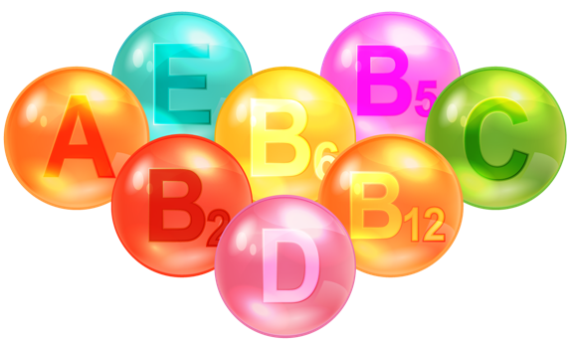
Vitamins at dsm-firmenich
Setting the global standard for essentials
For more than 80 years,
dsm‑firmenich has been a global reference in Vitamins,
combining unmatched portfolio breadth, scientific depth
and industry‑leading quality standards.
We support all 13 Vitamins with full safety data, regulatory dossiers and global certifications — serving personal care, nutrition and health applications at scale.
Our Vitamins are designed, manufactured and supplied under rigorous, industry-leading quality and safety frameworks, full traceability and stringent regulatory control, with EU‑based production as well as global supply reliability.
Beyond ingredients, our expertise spans biological science, formulation know‑how and sustainability leadership, enabling brands to build performance on foundations they can trust,
supported by ongoing scientific discovery and deep expertise.

Slide 3
Why the obvious is the next big thing
Vitamins, the healthy foundations of skin longevity
Science‑backed well aging essentials
Trusted for their safety, biological relevance & strong clinical evidence
In the race for new longevity actives, Vitamins risk being overlooked yet they play a critical role in key aging pathways.
Reframing Vitamins as targeted skin longevity cofactors,
highlights a simple truth:
Healthy aging
starts with essentials.

Slide 4
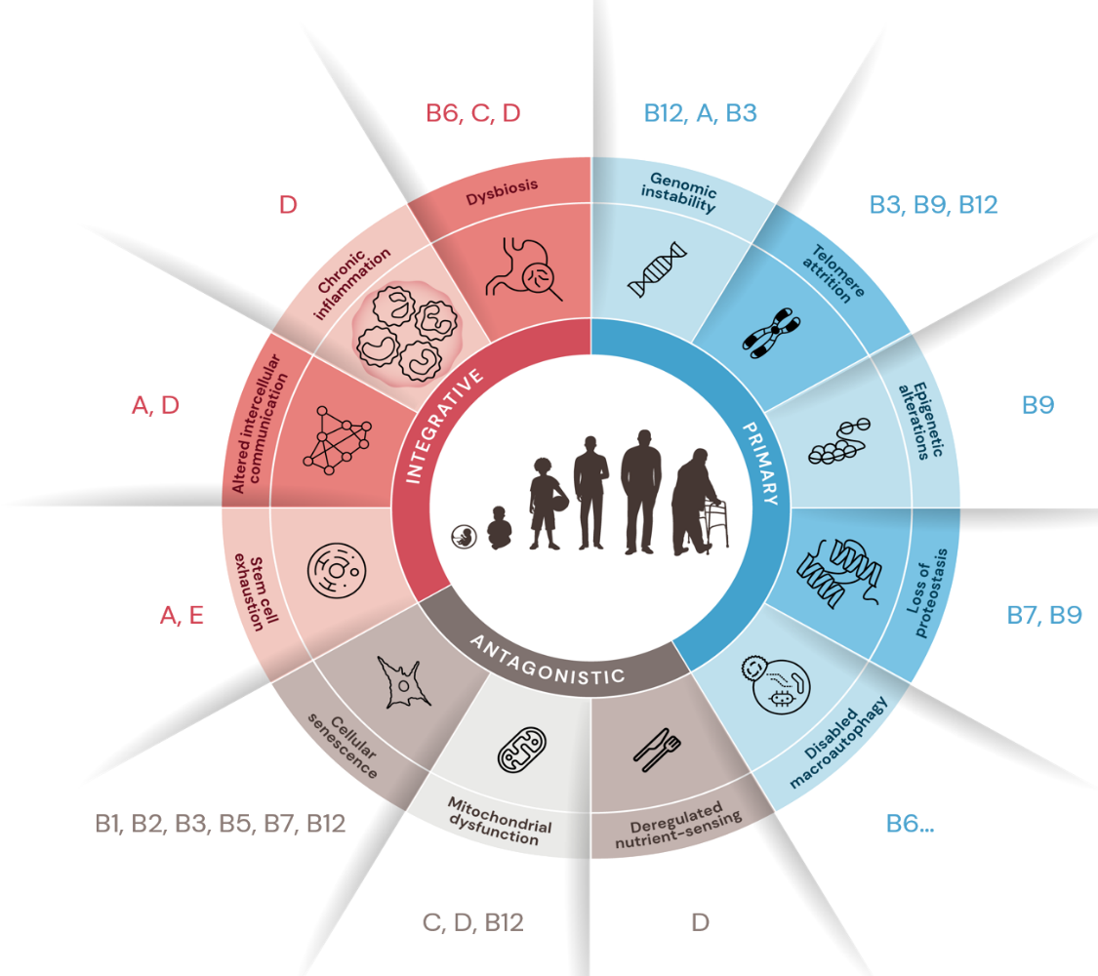
Modulating the hallmarks of aging
Vitamins as the skin non-negotiables
,C,B9
B5, B3, B12, B6,
Modern research connects Vitamins directly to core hallmarks of ageing and related pathways.
Vitamins are more than general antioxidants; They act as precision cofactors of skin longevity, plugging into cellular machinery at defined biological points.
As each Vitamin can influence multiple pathways, Vitamin-based skincare is a powerful strategy to simultaneously address various underlying causes of visible skin aging.
B12,C,
,B7
A,
A,
E, B3,
,B7
Figure 1: Modified from Personal Care Magazine article “Vitamins: modulating the hallmarks of skin ageing” B. Brockway, M. Gempeler, D. Imfeld

Slide 5
The hallmarks of aging
Simplified summary
Genomic instability → DNA damage accumulates sort of “typos” in the instruction manual, leading cells to function less accurately over time
Telomere attrition → Protective DNA end‑caps shorten with each cell division, limiting renewal and accelerating aging
Epigenetic alterations → The genetic control panel loses precision, cells are misprogrammed (e.g. they execute stress/aging instead of renewal)
Loss of proteostasis → Cells struggle to make, fold, and recycle proteins correctly, weakening structure and resilience
Disabled macroautophagy → Cellular “clean‑up” slows down, allowing damaged components to accumulate
Deregulated nutrient sensing → Cells misread nutrient & energy availability, disturbing growth, repair, & longevity pathways.
Mitochondrial dysfunction → Energy production declines and cellular stress increases, reducing vitality and repair capacity
Cellular senescence → Aged cells stop dividing but don’t disappear (zombie cells). They clutter the cellular space & jeopardize skin vitality
Stem cell exhaustion → The skin’s regenerative cell pool shrinks, slowing renewal and repair over time
Altered intercellular communication → Cells communicate less effectively, increasing inflammation and reducing coordinated repair
Chronic inflammation (inflammaging) → Persistent low‑grade inflammation damages tissue structure and accelerates aging
Dysbiosis → Imbalances in the skin microbiome impair barrier function, immunity, and skin homeostasis.
Simplification of cellular and molecular hallmarks system proposed by López-Otín C et al. Hallmarks of aging: An expanding universe. Cell. 2023; 186(2): 243-278

Slide 6

Vitamin C (Ascorbic Acid)
The skin longevity “non-negotiable foundation”
ALREADY WELL KNOWN FOR:
Supporting Collagen synthesis, and strengthening Collagen quality as co‑factor for enzymes that stabilize and cross‑link Collagen fibers*
Brightening skin tone, by inhibiting tyrosinase to reduce hyperpigmentation
Neutralizing reactive oxygen species (ROS)
WHY IT MATTERS FOR SKIN LONGEVITY?
A cornerstone of long‑term healthy-looking skin,
helping maintain skin’s structural resilience & repair capacity over time
Longevity Science
Epigenetic regulator, switches-on DNA repair pathways and helps counteract age‑related inefficiencies**
Longevity takeaway
A key longevity vitamin, preserving DNA stability & repair capacity over time.
Hallmarks highest fit:
Epigenetic alterations
Genomic instability
* Boyera et al. International Journal of Cosmetic Science. 1998; 20(3), 151–158
** Pavlovic et al. Open Medicine. 2023; 18(1);
Brabson, J. P., Leesang, T., Mohammad, S., & Cimmino, L. Epigenetic regulation of genomic stability by vitamin C. Frontiers in Genetics (2021.)
Notes:
Hallmarks fit
Epigenetics and Genomic instability
Dysbiosis and mitochondrial (indirect)

Slide 7


Vitamin B5 (Panthenol)
The “daily guardian” of skin resilience
ALREADY WELL KNOWN FOR:
Supporting skin natural repair process & strengthens the barrier renewal by fueling coenzyme A–dependent lipid synthesis, essential for long‑term resilience Moisturizing & soothing the skin
WHY IT MATTERS FOR SKIN LONGEVITY?
Supports long term skin resilience Longevity Science Reduces inflammatory pressure and can prevent senescence Supports high‑demand repair under environmental stressors (e.g. UV, pollution)
Longevity takeaway
The daily guardian of skin resilience, by preserving barrier, as well as supporting skin’s anti-inflammatory capacity*.
Hallmarks highest fit:
Chronic inflammation
Cellular senescence (prevention)
* Ebner et al. American Journal of Clinical Dermatology. 2002; 3(6), 427–433.
Notes:
Hallmarks fit:
Chronic inflammation
Senescence (prevention)

Slide 8

Vitamin B3 (Niacinamide)
The skin “cellular rehab”
ALREADY WELL KNOWN FOR:
Strengthening the skin barrier, as cofactor in Ceramides synthesis
Reducing uneven tone and improving fine lines
WHY IT MATTERS FOR SKIN LONGEVITY?
A multitasking Vitamin that helps restore cellular energy and repair pathways,
helping skin to perform at its best over time*
Longevity Science
NAD⁺ precursor, Niacinamide activates Sirtuin pathways that support Mitochondrial energy, DNA repair & Telomeres stability for lifelong performance
By calming low-grade inflammation, Niacinamide helps protect Collagen & Elastin, preserving skin structure over time
Longevity takeaway
All-in-one cellular rehab.
NAD⁺ booster & energy cofactor supporting DNA repair, anti‑inflammatory balance and long‑term skin resilience.
Hallmarks highest fit:
Mitochondrial dysfunction
Genomic instability
Telomere attrition
Chronic inflammation
Senescence (prevention)
* Oblong et al. Aging Cell. 2020; 19(10), e13248.
Notes:
NAD⁺ is like the “fuel” that turns on sirtuins. When sirtuins are active, they help cells make energy, fix damage, and protect DNA. To efficiently boost NAD+ Niacinamide needs to contain a minimum level of nicotinic acid (above 30ppm but less than 90ppm). This includes supporting mitochondria (the cell’s power plants) and helping keep telomeres stable, so cells stay functional for longer. When telomeres are stable, it means cells are less likely to become damaged, dysfunctional, or “aged” too early
Hallmarks fit:
Mitochondrial dysfunction
Genomic instability
Telomere attrition
Chronic inflammation
Senescence (prevention)

Slide 9

Vitamin B12 (Cobalamin)
The skin “gene-regulation supporter”
ALREADY WELL KNOWN FOR:
Supporting skin vitality by facilitating oxygen & essential nutrients supply
Contributing to healthy skin-nerve communication*
Reducing oxidative stress & chronic inflammation
WHY IT MATTERS FOR SKIN LONGEVITY?
Help keep skin cells stable, energized & resilient over time.
Longevity Science
It’s essential for DNA synthesis & methylation (chemical “on/off switch”)**
Through methylation, it restores epigenetic shift and regulates gene expression
Protects DNA & contributes to genomic stability
It can prevent senescence, mitochondrial damage & telomere shortening***
Hallmarks highest fit:
Genomic instability
Epigenetic alterations
Chronic inflammation
Senescence (prevention)
Telomer attrition (prevention)
Mitochondrial dysfunction (prevention)
Longevity takeaway
Supports cellular energy metabolism, DNA integrity and gene regulation,
helping skin cells stay stable, functional, and youthful over time.
* Calderón et al. CNS Neuroscience & Therapeutics. 2020; 26(1), 5–13
** Froese et al. Journal of Inherited Metabolic Disease. 2019; 42(4), 673–685
***Simonenko et al. Int. J. Molecular Sciences. 2024, 25, 5044
Notes:
Hallmarks fit:
Genomic instability
Epigenetic alterations
Chronic inflammation
Senescence (prevention)
Telomer attrition (prevention)
Mitochondrial dysfunction (prevention)

Slide 10

Vitamin B6 (Pyridoxine)
The skin proteins “quality-controller”
ALREADY WELL KNOWN FOR:
Supporting amino acid metabolism Contributing to immune function Supports proper Collagen cross links*
WHY IT MATTERS FOR SKIN LONGEVITY?
Helps maintain protein quality & immune function as skin ages Longevity Science Limits formation of advanced glycation that impair tissues biomechanics** It had been shown to regulate cellular cleaning by autophagy*** Helps control chronic low-grade inflammation linked to ageing****
Longevity takeaway
Contributes to supple, resilient skin by preserving protein integrity and immune equilibrium, potent anti-inflammatory effects.
Hallmarks highest fit:
Disabled macro-autophagy
Chronic inflammation
* Inubushi et al. BioFactors. 2005; 23, 59-67
** Ramis et al. Antioxidants. 2019; 8(344)
***Zhang et al. metabolites. 2022; 12, 1048
*** Mikkelsen etal. Biomedicines. 2023 (11) 2578
Notes:
Hallmarks fit:
Chronic inflammation
macroautophagy

Slide 11

Vitamin B9 (Folic Acid)
The skin cell “DNA-renewal cofactor”
ALREADY WELL KNOWN FOR:
Supporting cell division
WHY IT MATTERS FOR SKIN LONGEVITY?
Essential for maintaining DNA integrity in a high turnover tissue like skin.
Longevity Science
Supports DNA synthesis, repair & methylation*
Cofactor in protein methylation to maintain proteostasis
Protects against UV induced genomic instability**
Helps maintain telomere and epigenetic stability***
Longevity takeaway
Critical for preserving long-term genetic stability, epigenetic regulation for skin that functions properly over time.
Hallmarks highest fit:
Genomic instability
Epigenetic alterations
Telomere attrition
Loss of proteostasis
* Crider et al. Advances in Nutrition. 2012; 3(1), 21–38
** Jurzak et al. Pharmaceuticals. 2025; 18(10), 1497
*** Moores et al. Ann. N.Y. Acad. Sci. 1229 (2011) 76–88
Notes:
Hallmarks fit:
Telomere attrition
Epigenetic alterations
Loss of proteostasis
Genomic instability

Slide 12

Vitamin A (Retinol)
The skin longevity “re-programmer”
ALREADY WELL KNOWN FOR:
Improving wrinkles and uneven tone Accelerating epidermal turnover
WHY IT MATTERS FOR SKIN LONGEVITY?
A cornerstone of long-term skin renewal Longevity Science Limits cellular senescence, by resetting age‑altered cell behavior through RAR/RXR (nuclear receptors)‑mediated gene programs* Supports Collagen, Elastin and Fibronectin synthesis while limiting ECM‑degrading enzymes, helping prevent dermal structural decline Counteracts impaired cellular communication, by improving signaling & reducing senescence‑associated dysfunctions that can disrupt coordinated skin renewal**
Longevity takeaway
Supports lifelong skin health span by resetting age‑altered cell behavior
and maintaining dermal tissue integrity over time.
Hallmarks highest fit:
Cellular senescence
Altered intercellular communication
Loss of proteostasis
* Mambwe et al. Int J Cosmet Sci. 2025;47(1):45-57.
** Quan T. Biomolecules. 2023;13(11):1614..

Slide 13

Vitamin B7 (Biotin)
The ’’metabolic and epigenetic balance-keeper”
ALREADY WELL KNOWN FOR:
Biotin acts as a cofactor for key enzymes, helping skin cells convert nutrients into energy and essential lipids, supporting healthy‑looking skin, hair and nails
WHY IT MATTERS FOR SKIN LONGEVITY?
Helps skin cells stay energized and keeps gene activity properly regulated over time
Longevity Science
Epigenetic control via biotinylation of histones and gene regulation*
Helps maintain mitochondrial function and metabolism**
Longevity takeaway
Preserves metabolic and mitochondrial function and acts as epigenetic modulator
Hallmarks highest fit:
Epigenetic alterations
Mitochondrial dysfunction
* Karachaliou et al. Int. J. Mol. Sci. 2024, 25, 6578
**Lohr et al. PNAS, 2020; 117(52), 33608-33618
** Madsen et al. nature communications. 2015, 6, 7726
Notes:
Hallmarks fit:
Epigenetic alterations
Mtiochondrial dysfunction

Slide 14

Vitamin D (Calciferol)
The skin longevity “immune orchestrator”
ALREADY WELL KNOWN FOR:
Supporting calcium metabolism Contributing to immune defense
WHY IT MATTERS FOR SKIN LONGEVITY?
By orchestrating immune & inflammatory response, and supporting cellular protection mechanisms, Vitamin D helps sustain skin homeostasis over time Longevity Science Enhances mitochondrial protection Protects against inflammaging Supports DNA repair and photoprotection mechanisms*
Longevity takeaway
Supports long‑term skin health by controlling inflammaging and preserving coordinated immune, as well as repair responses.
Hallmarks highest fit:
Mitochondrial dysfunction
Chronic inflammation
Bocheva et al. International Journal of Molecular Sciences. 2021; 22(16), 9097.
Vitamin D is not authorized for cosmetic use in the EU or in major LATAM markets, including Brazil, Mexico, the Andean Community Countries, and Argentina. Any references are provided for scientific context only and do not imply cosmetic use or commercialization in those Countries

Slide 15

Vitamin E (Tocopherol)
The skin longevity “membrane protector”
ALREADY WELL KNOWN FOR:
Protecting lipids from oxidation
Limiting Collagen degradation under UV stress, supporting skin smoothness
WHY IT MATTERS FOR SKIN LONGEVITY?
Acts at the membrane level — where oxidative damage initiates cellular decline*
Longevity Science
Stabilizes mitochondrial membranes, limiting lipid peroxidation and toxic by‑product formation, helping cells maintain repair functions over time
Breaks ROS amplification loops that impair energy production
Longevity takeaway
Protects skin’s structural and barrier systems against long term oxidative wear.
Hallmarks highest fit:
Mitochondrial dysfunction
Stem cell exhaustion
* Aparecida et al. IntechOpen; 2021

Slide 16
Disclaimer
Copyright © dsm-firmenich Switzerland AG, 2026, 4002 Basel, Switzerland.
www.dsm-firmenich.com. All rights reserved.
dsm-firmenich has used diligent care to ensure that the information provided herein is accurate and up-to-date to the best of its knowledge. However, dsm-firmenich makes no representation or warranty, either expressly or implied, of the accuracy, reliability, completeness, or suitability thereof. The information provided herein contains scientific and product information for business-to-business use and does not constitute or provide scientific or medical advice, diagnosis or recommendation for treatment options. Country or region-specific information should be considered when labelling or advertising to final consumer. In no event shall dsm-firmenich be liable for any direct or indirect damages arising from or reliance upon, or use of, any information provided herein. The content of this document is subject to change without further notice. Please contact your local dsm-firmenich representative for the latest information. All trademarks listed in this document are either (registered) trademarks of, or trademarks licensed by, the dsm-firmenich group of companies, unless explicitly stated otherwise.
Disclaimer Formulation Guideline
The information provided herein is provided for information purposes only and has been prepared by dsm-firmenich in accordance with its own methodology.
dsm-firmenich has used diligent care to ensure that it is accurate and up-to-date, however, dsm-firmenich makes no representation or warranty, either expressly or implied, of the accuracy, reliability, or completeness thereof. In no event shall dsm-firmenich be liable for any damages arising from or reliance upon, or use of, any information provided herein. Further, dsm-firmenich shall not bear any liability for the application and/or use of any processed material containing its product(s). The formulation of the finished product is the customer’s sole responsibility. It is the customer’s responsibility to determine the suitability of dsm-firmenich’s products regarding user specific purposes, assess compatibility and stability of their finished product(s) and to ensure compliance of their finished product(s) with relevant laws and regulations. Any product, marketing or other claims made by customer are its sole responsibility. The content of this document is subject to change without further notice. Please contact your local dsm-firmenich representative for further details. © dsm-firmenich Switzerland AG, 2026.
© 2026

